Slide 1
CSQCD VII, New York
Hybrid Stars and Star Mergers
OUTLINE
phenomenolgy of neutron stars
hyperons in the core
quark matter in the star
magnetic fields
lessons from the merger signal
V. Dexheimer, R. Mallick, P. Mehta, R. Nandi, R. Negreiros, B. Franzon, R. Gomes, A. Mukherjee, J. Steinheimer, A. Motornenko, SWS
FIAS ,Kent State, Rio de Janeiro, Porto Alegre, Bhopal , Mumbai

Slide 2
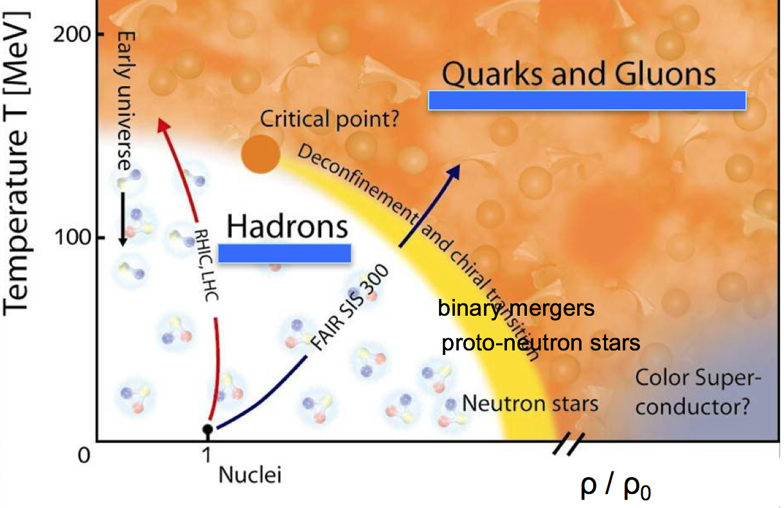
multi-messenger astronomy ➛ multi-message theory
phase diagram of
strong interactions
connect both worlds
in some reasonable way
Practical model useful for heavy-ion simulations and compact star physics
correct asymptotic degrees of freedom
reasonable description on a quantitative level for high T down to nuclei
possibility of studying first-order as well as cross-over transitions

Slide 3
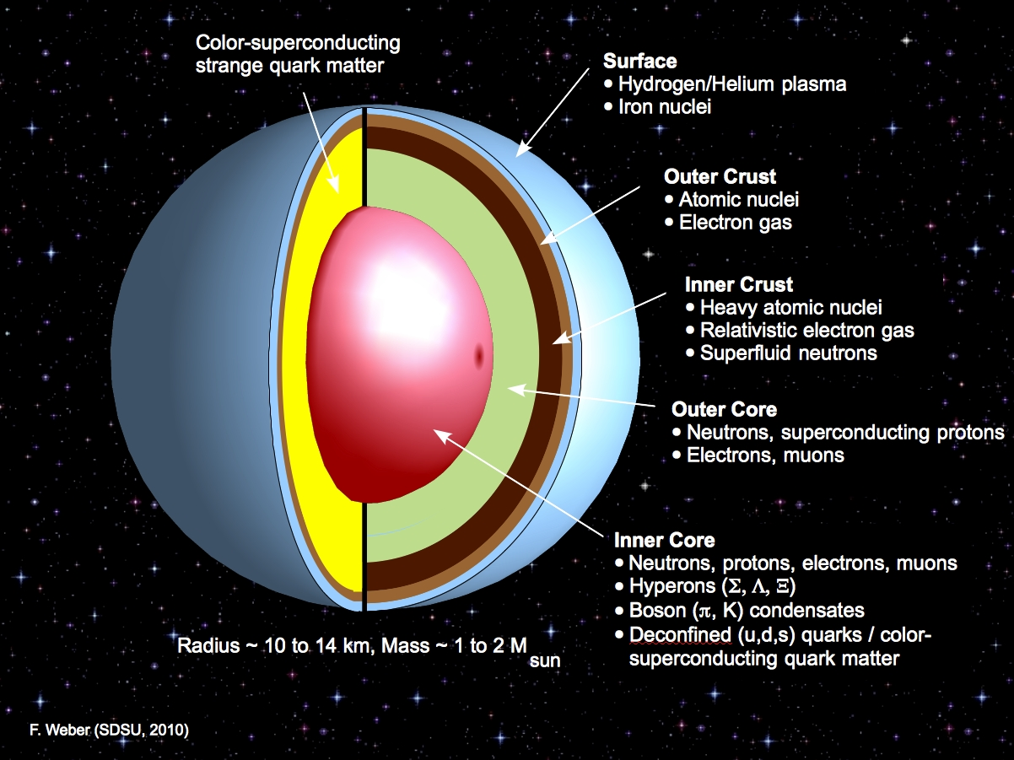
neutron stars are remnants of Type II supernovae
1 to 2 solar masses, radii around 10 - 15 km
maximum central densities 4 to 10 ρ₀
more than 2600 known neutron stars
hyper star
hybrid star

Slide 4
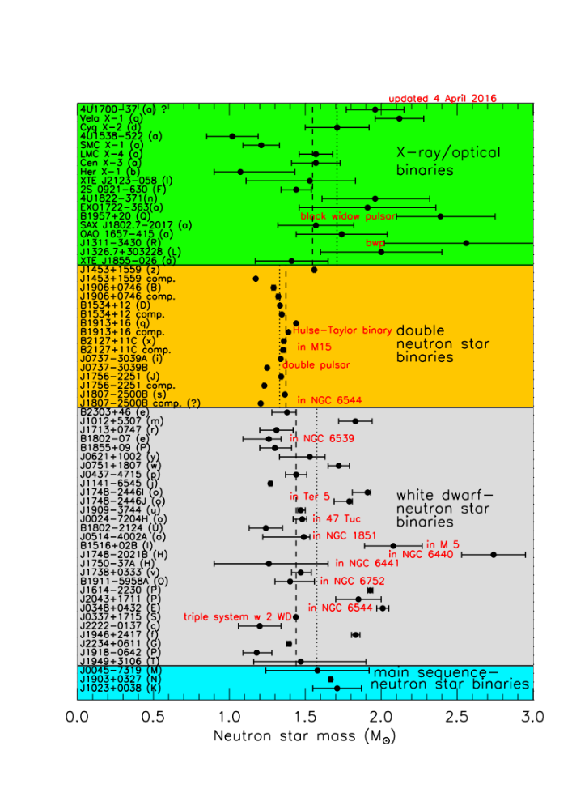
Masses of Neutron Stars
benchmark for NS models
M = (1.97 +- .04) M₀
Demorest et al. Nature 467, 1081 (2010)
new observation PSR J0348+0432
M = (2.01 +- .04) M₀
Antoniadis et al. Science 340, 448 (2013)
well established - heavy neutron stars
Lattimer, Ann. Rev. .Nucl. & Part. Sci., 62, 485 (2012)
Notes:
Constantly updated graph

Slide 5
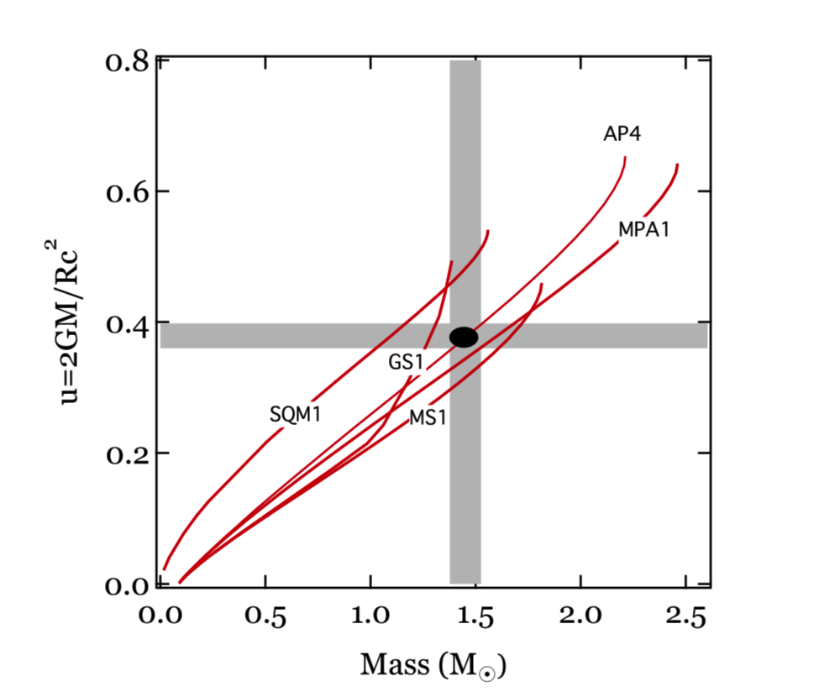
Neutron Star Radii
X-ray bursters, use luminosity, temperature information to extract radius
10.4 km < R < 12.9 km analysis of range of EOS, PRE XB, qLMXB
9 km < R < 11 km
PRE XB
Özel et al., PRD 82, 101301(R)
Steiner et al., APJL 765, L5
R > 14 km
PRE 4U 1724-307
Suleimanov et al., APJ 742, 122
7.6 km < R < 10.4 km
single R, qLMXB
Guillot et al, APJ 772, 7
10.4 km < R < 11.3 km
bursts, qLMXB
Özel et al, APJ 820, 28
tendency towards small radii
Neutron Star Interior Composition Explorer (NICER)
measure non-uniform thermal X-ray emission
from rotating neutron stars
determine compactness M/R ,
combine with mass measurement
From Ozel et al, APJ 843, 93 (2016)

Slide 6
CMF - hadronic SU(3) approach based on non-linear realization of σω model
Lowest multiplets
B = { p , n , Λ , Σ^{±/0} , Χ^{-/0} }
baryons
diag (V) = { (ω + ρ) / √2 , (ω - ρ) / √2 , ϕ }
vector mesons
diag (X) = { (σ + δ ) / √2 , (σ - δ) / √2 , ς }
scalar mesons
Mean fields generate masses, scalar attraction and vector repulsion
error in energy ε (A > 50) ~ 0.17 %
ε (A > 100) ~ 0.12 %
nuclear properties
+ correct binding energies of hypernuclei, reasonable charge radii
SWS, Phys. Rev. C66, 064310
new fit in the works – requires parameter fine-tuning
combine with crust simulations

Slide 7
constraints for the nucleonic part of the equation of state
nuclear matter saturation density 𝛒₀ ≈ 0.15 – 0.17 fm⁻³ )
binding energy per nucleon E/N ≈ 15 - 16 MeV
(in-)compressibility 𝛋 = 9 (dP/d𝛒) | _{𝛒0} ≈ 190 – 270 MeV
(a-)symmetry energy S = ½ ρ₀² d²(ε/ρ) / [d(ρ_{p} – ρ_{n})]² ≈ 25 – 35 MeV
slope parameter L = 3 ρ₀ (dS / dρ)(ρ₀) ≈ 30 – 100 MeV
sources for constraints – nuclear masses, GDR, Sn isotopes, flow studies, ...
Surveys:
Dutra et al, Phys. Rev. C 85, 035201 (2012) (240 Skyrme parametrizations)
Dutra et al, Phys. Rev. C 90, 055203 (2014) (263 RMF models)

Slide 8
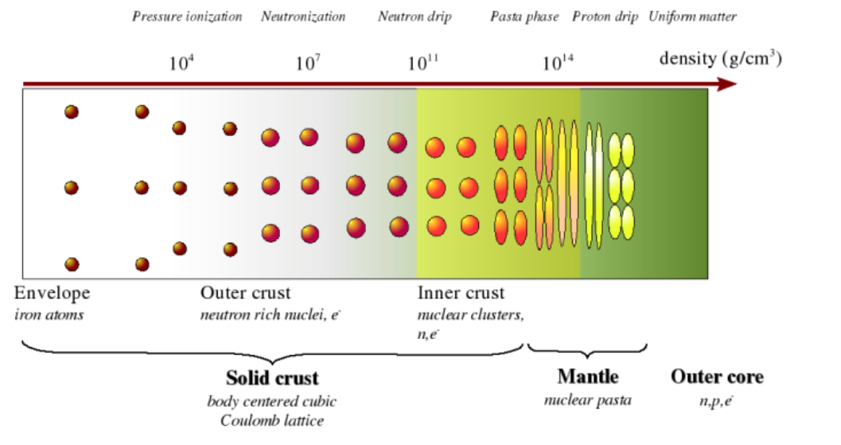
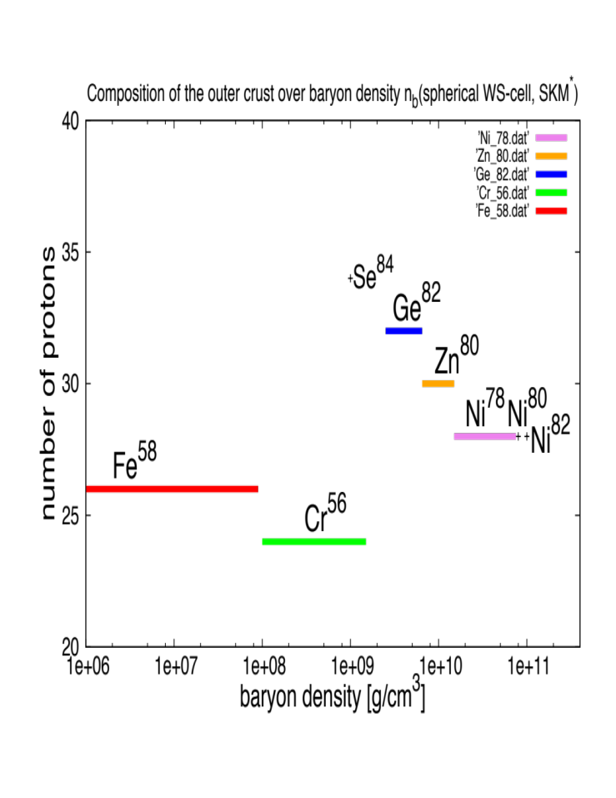
structue of the crust
non-accreting crust (BPS)
ρ [g/cm³]
⁵⁶Fe 8.1×10⁶
⁶²Ni 2.7×10⁸
⁶⁴Ni 1.2×10⁹
⁸⁴Se 8.1×10⁹
⁸²Ge 2.2×10¹⁰
⁸⁰Zn 4.9×10¹⁰
⁷⁸Ni 1.6×10¹¹
⁷⁶Fe 1.8×10¹¹
¹²⁴Mo 1.9×10¹¹
¹²²Zr 2.7×10¹¹
¹²⁰Sr 3.7×10¹¹
¹¹⁸Kr 4.3×10¹¹
Chamel, Haensel,
Living Rev. Relativity 11, 10 (2008)
results can be very model-dependent
see e.g. Rüster et al, PRC 73, 035804 (2006)
U. Heinzmann

Slide 9
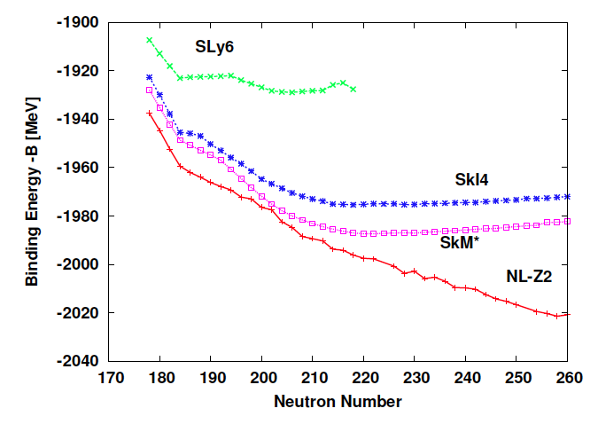
extreme example - total binding energy –B (MeV) for Uranium Isotopes
side remark - drip line for heavy nuclei highly uncertain (far beyond crust conditions)
more parameter sets
behave similarly
← lower slope L higher →
SWS,Gridnev,Tarasov,Tarasov,Geiner, IJMPE21, 1250047

Slide 10
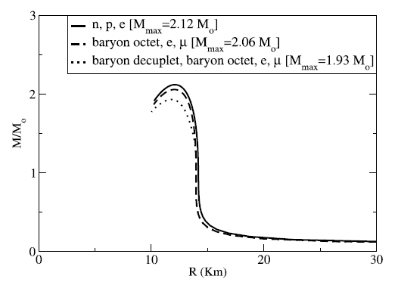
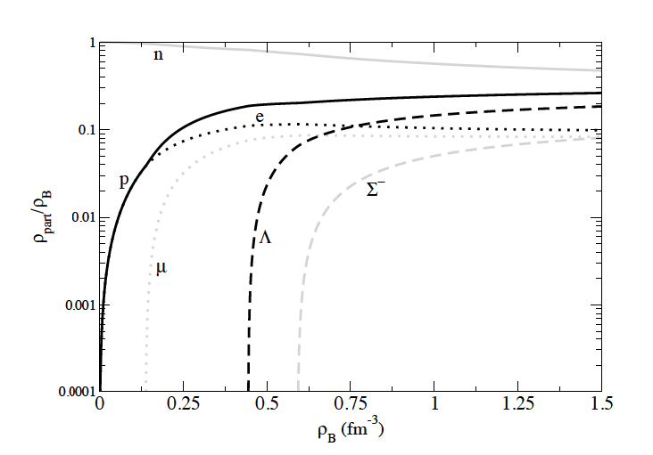
Neutron star masses including different sets of particles
Tolman-Oppenheimer-Volkov
equations, static spherical star
changing masses with degrees of freedom
large star masses even with spin 3/2 resonances
normalized particle densities
Dexheimer, SWS ApJ 683, 943

Slide 11
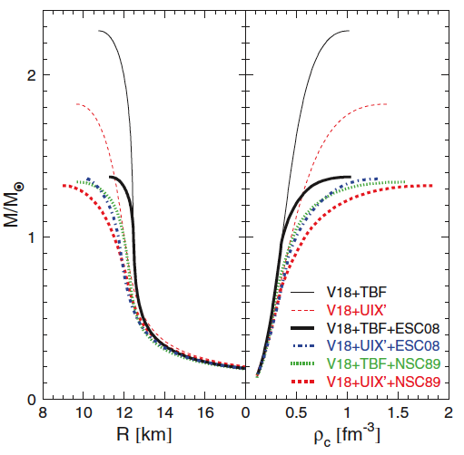
Neutron Stars with Hyperons
relatively easy to generate heavy stars with nucleonic EOS M_{max} ~ 2.8 M (NL3)
~ 2.2 M (APR)
Causal limit beyond ρ_{c} -
Rhoades, Ruffini (1974): M_{max} < 3.2 M
additional degrees of freedom soften the equation of state
reducing the maximum star mass
“hyperon puzzle”
Nijmegen potential
H
hyper stars tend to have small mass
e.g.
Vidaña et. al., EPL 94 11002
Schulze et. al, PRC 84, 035801
…
most HN scattering data from the 60’s !
no corresponding HH data
Schulze, Rijken, PRC 84, 035801 (2011)

Slide 12
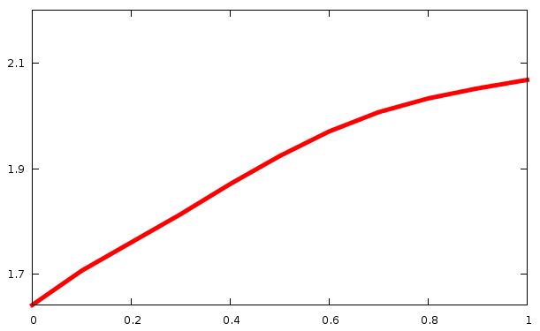
“Hyperon Puzzle”
many hyperons soften EOS, reduce star masses significantly
_
hyperon-hyperon repulsion - impact of ss vector field Φ
strong nonlinear hyperon-nucleon interaction ( Lonardoni et al, PRL 114 092301)
rescale g_{BΦ} coupling parameters, f_{s}(core) varies between 0.1 and 1
2.1
f_{s} = n_{s} / n_{B}
M_{max} [M]
hyper star with few
hyperons
1.7
no coupling
standard fit
Dexheimer, SWS ApJ 683, 943 (2008)

Slide 13
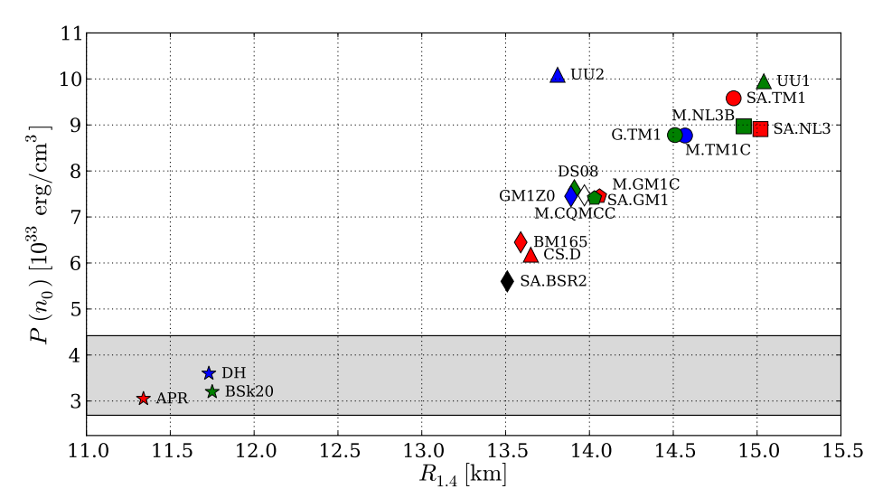
pressure of star matter at ρ_{o}
Χ_{M}
Χ_{M}*
chiral EFT
Hebeler et al, ApJ 773, 11
QχP
“working” hyper star models fail at smaller densities?
not necessarily
Fortin et al., A&A 576, A68 (2015)

Slide 14
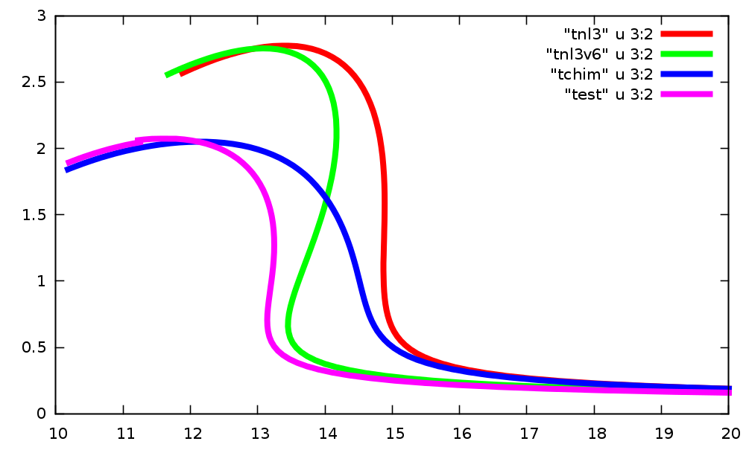
effect of vector self-interactions
Dexheimer, Negreiros, SWS, PRC92, 012801(R)
Horowitz, Piekarewicz, PRC66, 055803
SWS, PLB 560, 164
non-linear isoscalar-isovector interactions like V ~ ρ²ω²
non-trivial density dependence of isospin terms
maximum mass unchanged
M [M]
NL3
substantial reduction
of radii
ᵡ_{M}
Radius [km]

Slide 15
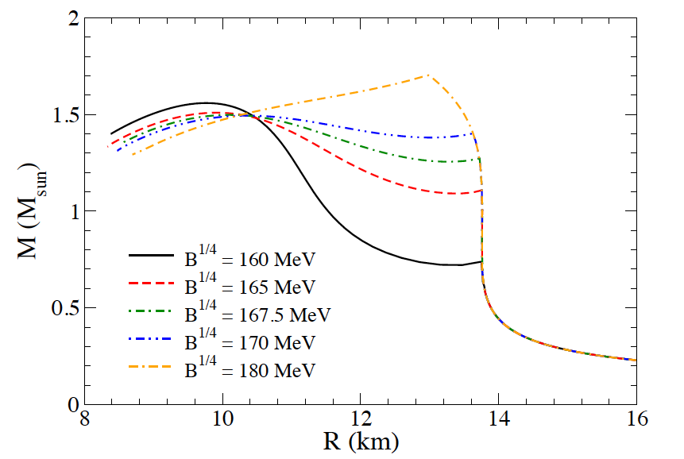
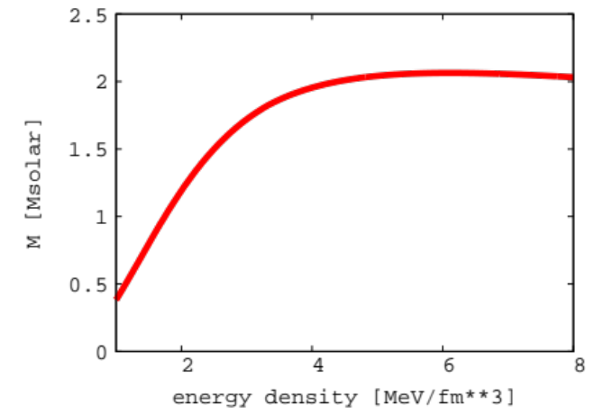
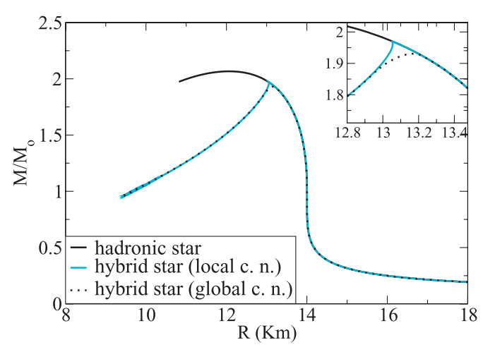
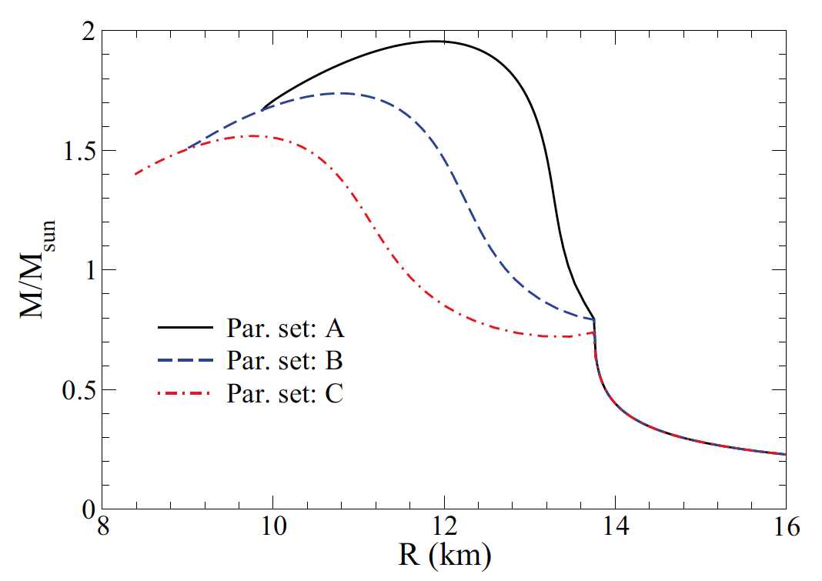
Hybrid Stars, Quark Interactions
no α_{s}
line nearly flat
central density [ρ₀]
ingredients –
Standard baryonic EOS (G300)
plus MIT bag model + α_{s} corrections
unified hadron-quark model
B^{1/4}=139
α=0.7
B^{1/4}=160
α=0.1
Negreiros, Dexheimer, SWS, PRC85 035805
Dexheimer, SWS, PRC81 045201
baryons alone M_{max} ~1.8 M_{solar}

Slide 16

hadrons, quarks, Polyakov loop and excluded volume
Include modified distribution functions for quarks/antiquarks
*
*
Φ confinement order parameter
plus Polyakov loop potential U(Φ ,T)
Ratti et al, EPJC49, 213
quarks couple to fields
The switch between the degrees of freedom
is triggered by hadronic excluded volume corrections
first-order, second-order, crossover transitions possible
no reconfinement!
equation of state stays causal
Steinheimer,SWS,Stöcker JPG 38, 035001

Slide 17
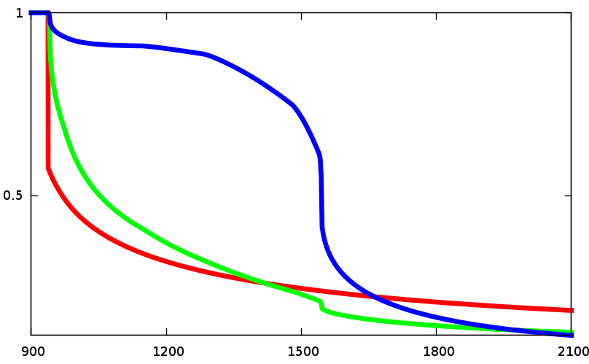
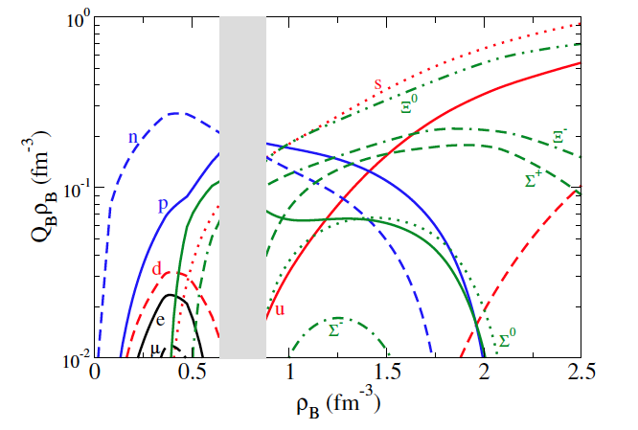
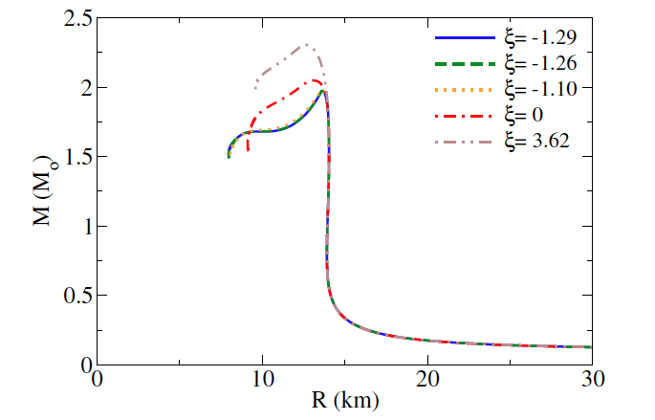
star matter in beta equilibrium in QH approach
1st order phase transition
in star matter possible
cross over in symmetric matter
s quarks appear
ζ/ζ_{o}
σ/σ_{o}
f_{s}(core) jumps to ~ 1
particle cocktail
μ_{B}
star masses M varying quark interactions
hybrid star
Mass ~ 2 – 2.3 M Radius ~13 km
Dexheimer,Negreiros,SWS PRC91, 055808

Slide 18
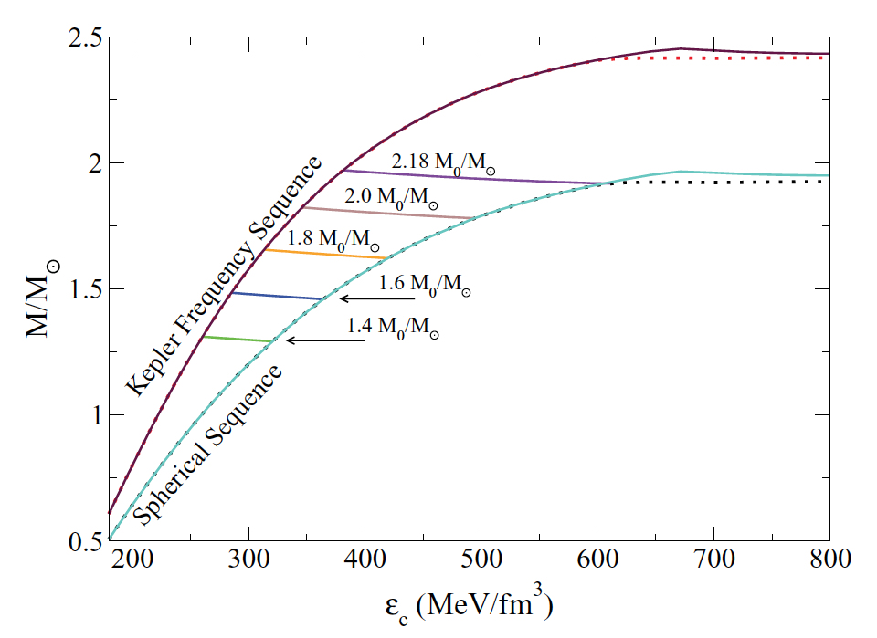
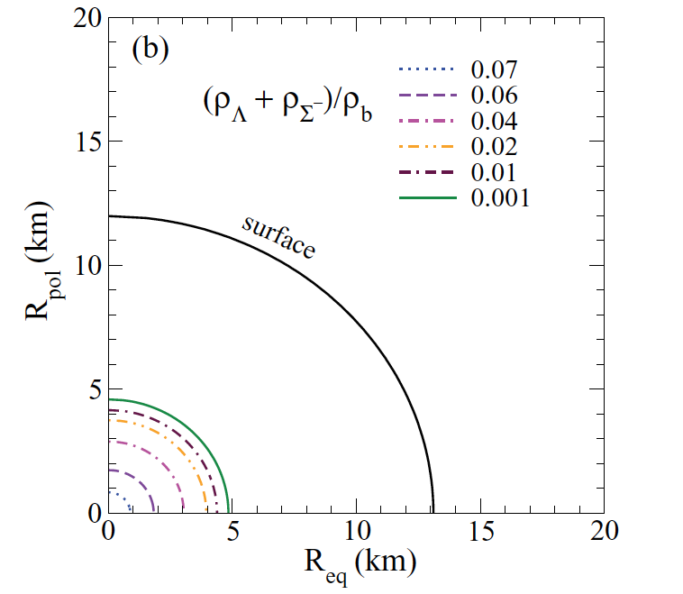
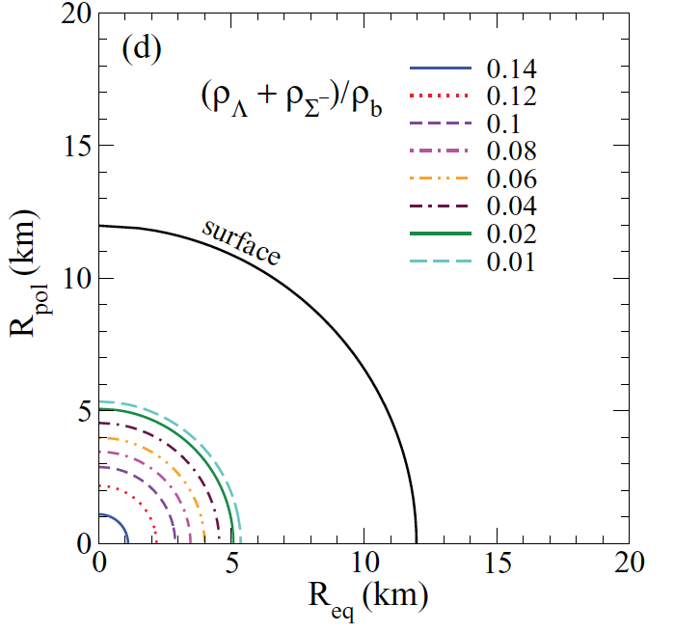
Effect of rotation
relatively small changes in M, M_{max}
substantial decrease in central density
PSR J1748-2446 Ω = 716 Hz
fixed baryon number (Ω_{K}~ 990 Hz)
Ω = 600 Hz
f_{s}
f_{s}
f_{s} doubled
Ω = 0
Negreiros, Dexheimer, SWS, PRC82 035803
hybrid stars behave in the same way

Slide 19
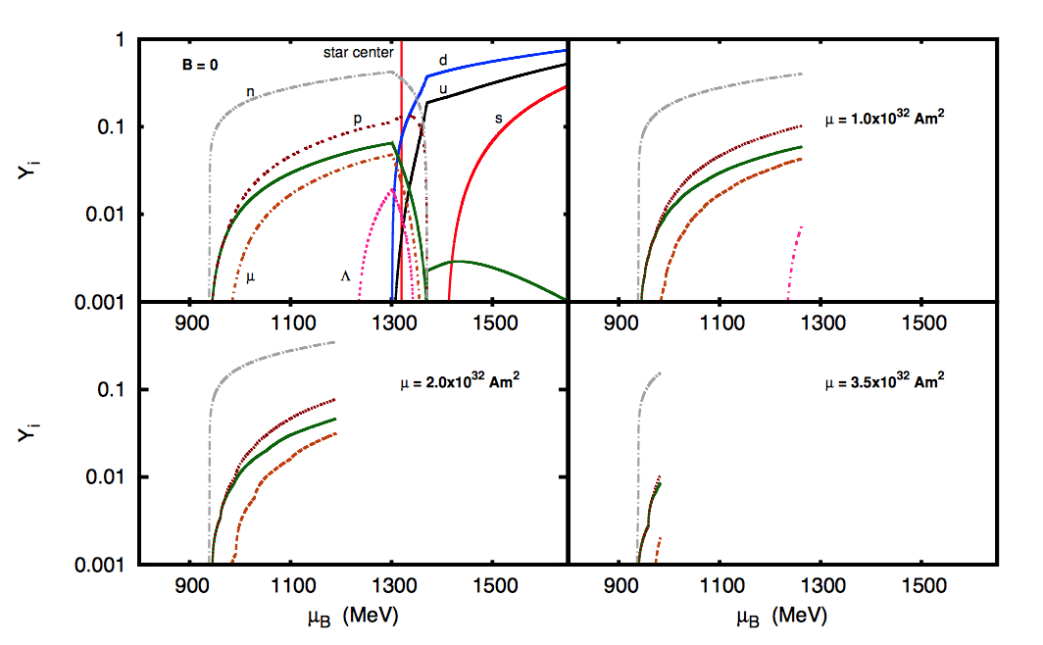
effect of strong magnetic fields on hybrid star
B_{c} = 5*10¹⁷ G
B_{c} = 9.1*10¹⁷ G
B_{c} = 8.8*10¹⁷ G
equation of state is not strongly affected by B fields, but the population is!
possible effects for slow rotators (magnetars)
Franzon, Dexheimer, SWS, MNRAS 2016
Franzon, Gomes, SWS, MNRAS 2016

Slide 20
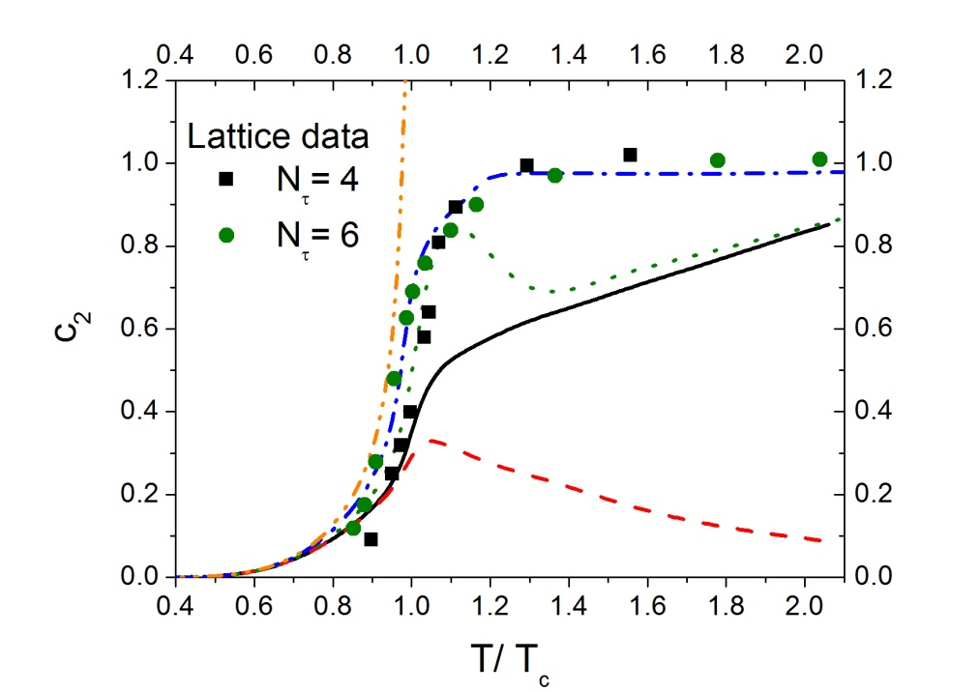
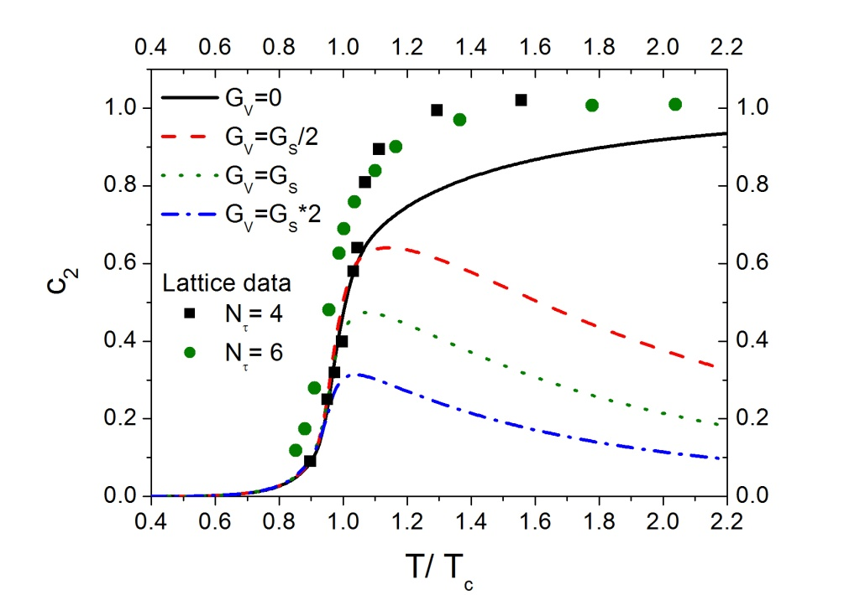
Susceptibilitiy in PNJL and CMF-Q model for different quark vector interactions
P(T,μ) = P(T) + c₂(T) μ² T² + …
small quark vector repulsion !!
QH
g_{qω} = 0
PNJL
g_{qω} = g_{nω} /3
same behavior for strangeness
susceptibilities
Steinheimer, SWS, PLB 696, 257
Rau et al, Phys.Lett.B733, 176

Slide 21
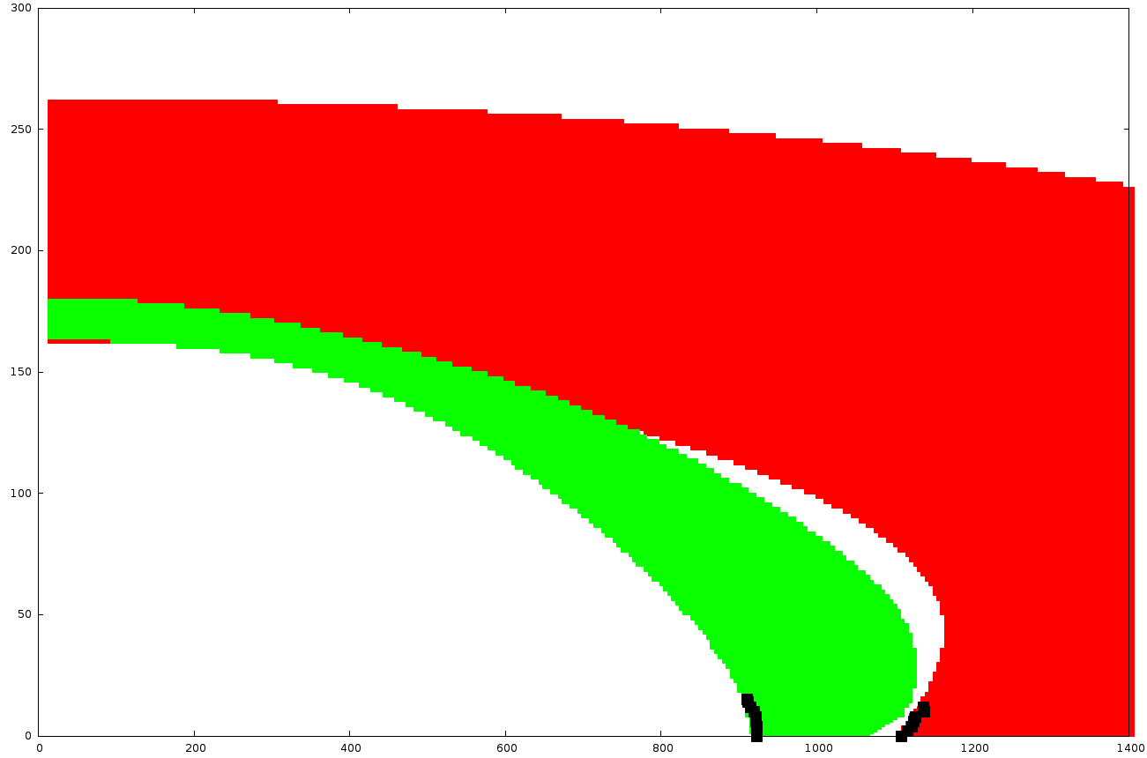
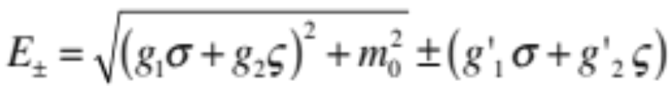
Excited quark-hadron matter in the parity-doublet approach
doublet candidates – N(1535), Λ(1670), Σ(1750), Ξ (?) overall unclear
T[MeV]
Φ = 0.8
Chiral transition
200
Liquid-gas phase transition
σ/σ_{o} = 0.8
100
compressibility 267 MeV (!)
asymmetry energy 30 MeV
slope parameter 57 MeV (!)
400
800
1200
𝛍_{B} [MeV]
single particle energies
Mukherjee, SWS, Steinheimer, Dexheimer, A&A 608, A110
Steinheimer, SWS, Stöcker, JPhysG 38, 035001
Y. Motohiro et al. PRC 92, 025201
chirally invariant mass term

Slide 22
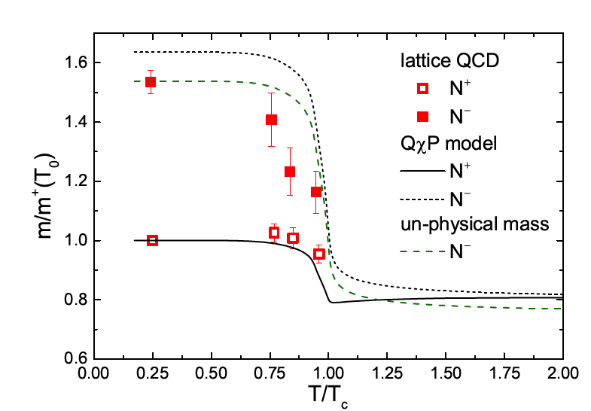
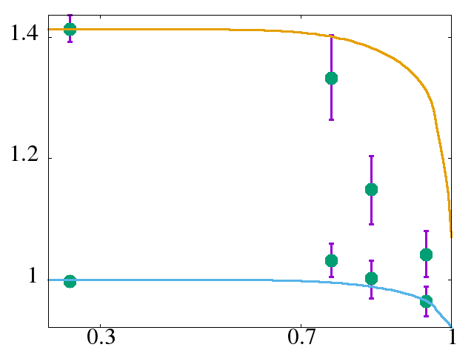
negative parity state on the
lattice and in the model
lattice data from Aarts et al,
J. High Energ. Phys. (2017) 2017: 34
EPJ Conf. 175, 07016 (2018)
Mukherjee, Steinheimer, SWS, PRC (2017)
similar results for hyperons
𝚵
m/m⁺(T₀)
Conclusions from lattice susceptibilities
No quark repulsive interactions!
T/T_{c}

Slide 23
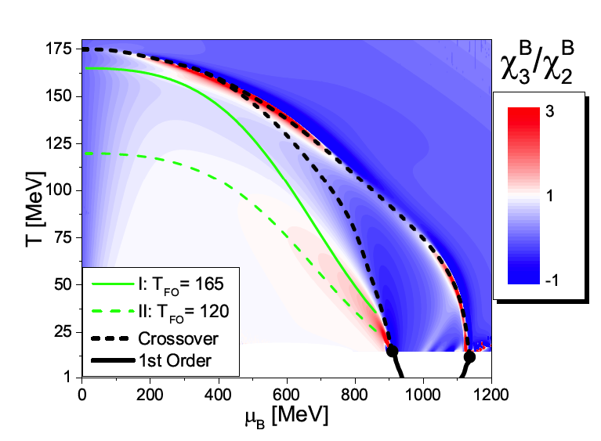
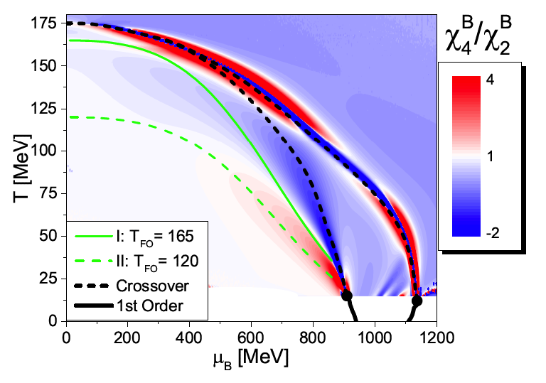
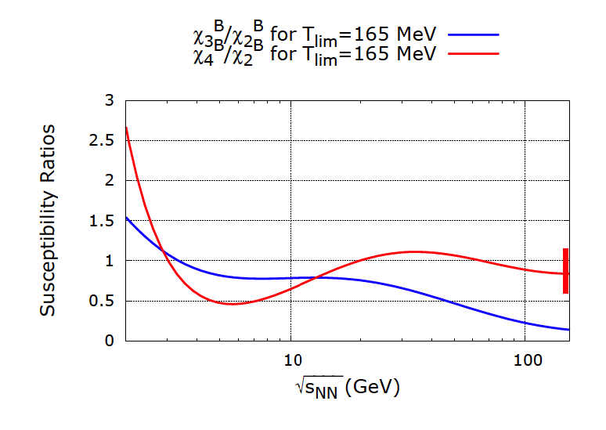
fluctuations in heavy-ion collisions
susceptibilities 𝝌^{B}_{n} as marker of interesting phase structures
importance of liquid-gas transition
𝝌^{B}_{n} ~ n! c^{B}_{n}
susceptibilities along freeze-out line
(temperatures rescaled)
Mukherjee, Steinheimer, SWS, PRC (2017)

Slide 24
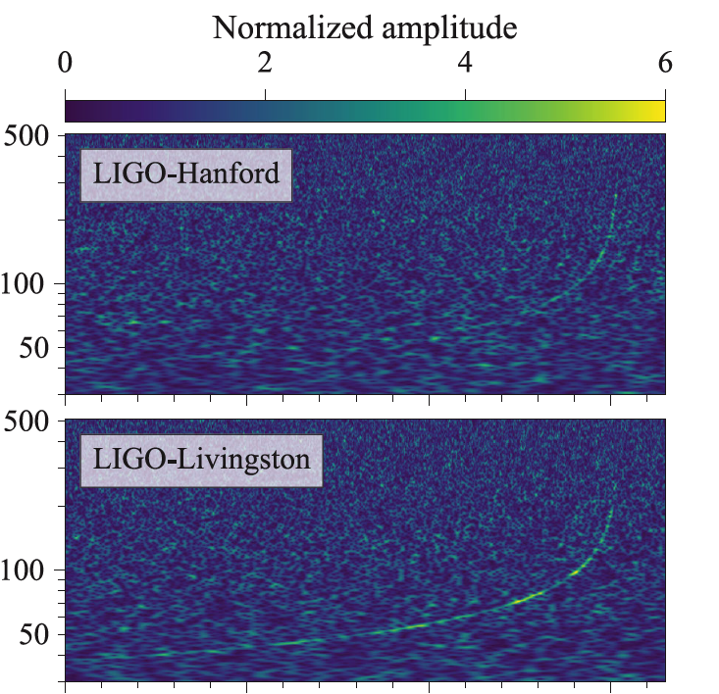
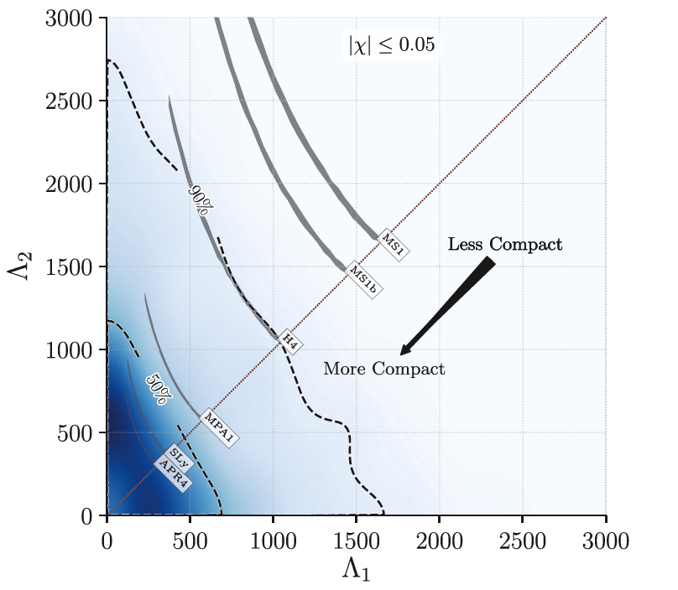
gravitational wave signal GW170817
NS merger , distance of ~ 40 Mpc
followed by GRB (GRB170817A) and optical/infrared signal (AT2017gfo)
frequency
chirp mass (m₁m₂)^{3/5}/(m₁+m₂)^{1/5} ~ 1.188 M⊙
Masses of 1.1 to 1.6 M⊙. Total M ~2.74 M⊙
from Abbott etl al, PRL119, 161101 (2017)
EoS-dependent deformability
Λ ~ k₂ (R/M)⁵
Love number
Λ(1.4 M⊙) < 800, 1400

Slide 25
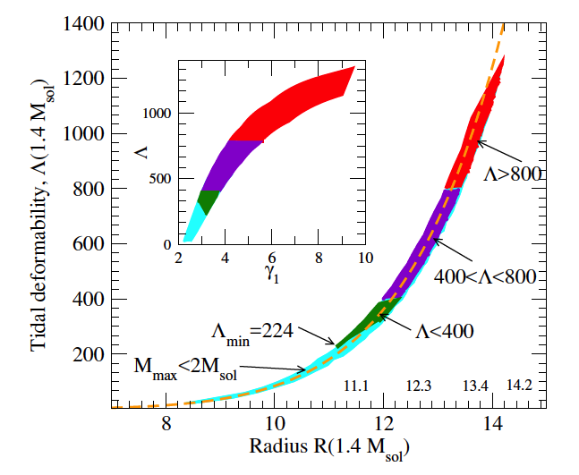
deformability constraints, hybrid stars
Annala et al, arXiv:171.02644
connecting low-density hadronic and pQCD high density EOS by piece-wise polytropes
11 km < R(1.4 M⊙) < 13.4 km
masses below 2 M⊙
- see also Bandyopadhyay et al., EPJA (2018)
Nandi, Char, arXiv:1712.08094
Alvarez-Castillo et al, arXiv:1805:0410
Gomes, Char, SWS, arXiv:1806.04763
...

Slide 26
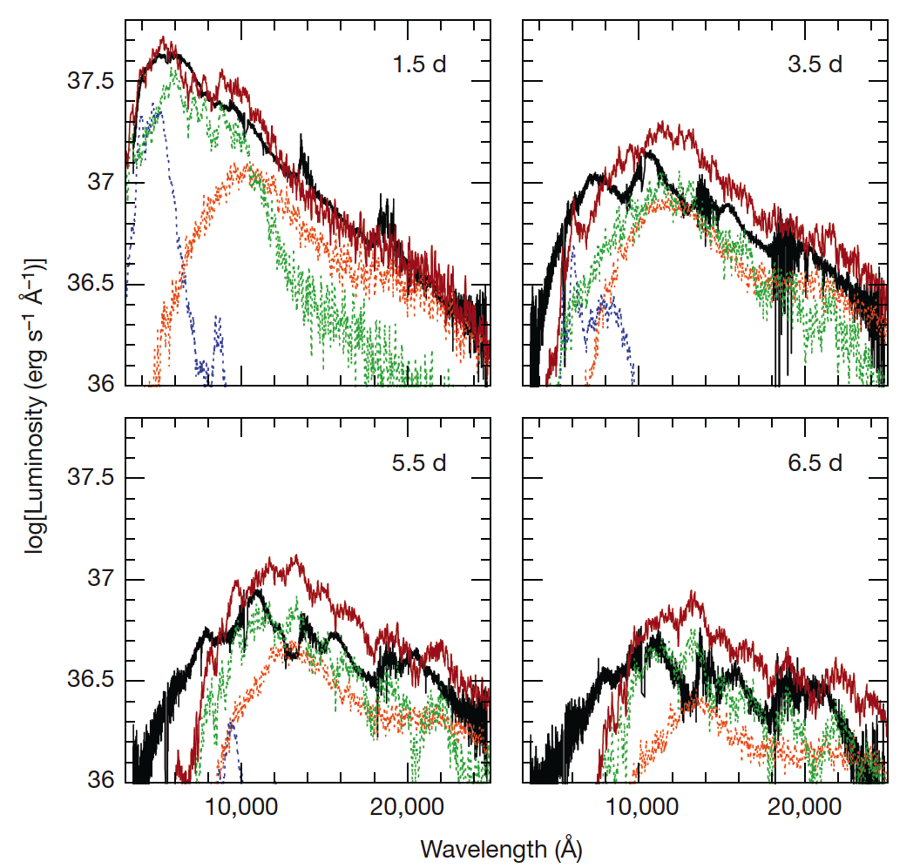
The optical features correlated with GW170817
Ejected material 0.03 – 0.05 M_{solar} of fast expanding source
time structure depends on opacities
(Lanthanides Z ~60 have very high opacities)
reasonable fit to data
shows three components with different Y_{e}
contributing to the signal
From Pian et al, Nature 551, 67 (2017)

Slide 27
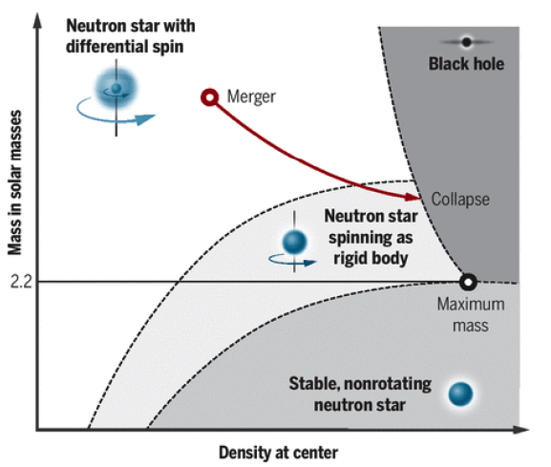
estimate for maximum static masses
idea: signal points to uniformly maximally rotating star at point of collapse
total mass known ➙ convert to baryon mass ➙ subtract ejecta mass
➙ estimate for max baryon number non-rotating ➙ convert back to TOV mass
Margalit, Metzger, APJ (2017): M_{max} < 2.17 M⊙
Shibata et al, PRD (2017): 2.15 M⊙ < M_{max} < 2.25 M⊙
Rezzolla et al, APJ (2018): 2.01 M⊙ < M_{max} < 2.16 M⊙
Ruiz et al, PRD (2018): 2.16 M⊙ < M_{max} < 2.28 M⊙
from Cho, Science 359, 724 (2018)

Slide 28
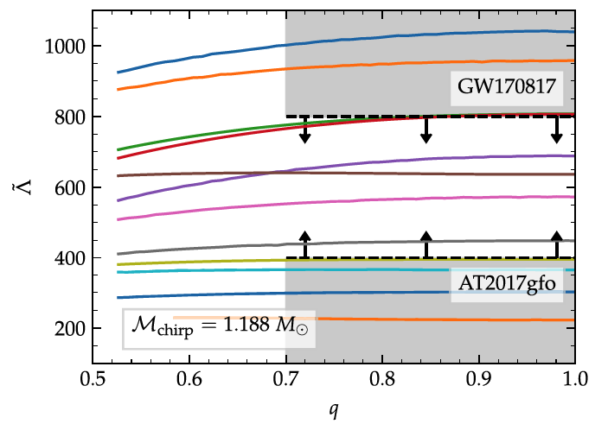
deformation parameter and el.-mag. luminosites
argument - low deformability, compact stars
fast collapse into black hole
small mass of disk matter
lower limit for deformation parameter
from electromagnetic signal / mass of disk
range of deformation parameter
Analysis from Radice et al, APJL 852, L29 (2018)

Slide 29
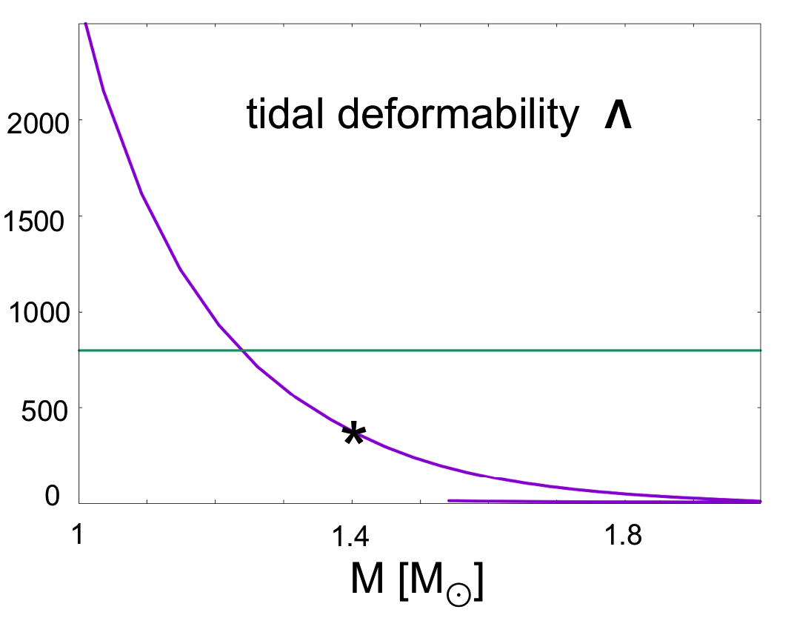
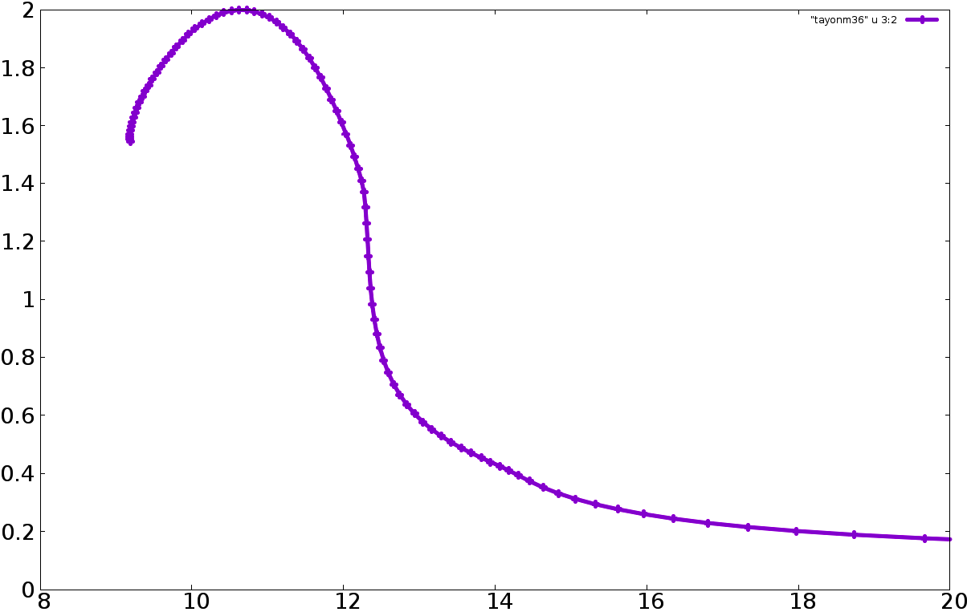
model results for star masses, radii, deformability
deformability 𝝠 as function of mass
for GW170817 chirp mass
combined 𝝠 between 430 and 450
2.0
40 %
1.6
quark fraction
CMF-Q model results in agreement
with observation
merger calculations in progress
M [M⊙]
1.2
25 %
0.8
0.4
8
12
16
20
R [km]

Slide 30
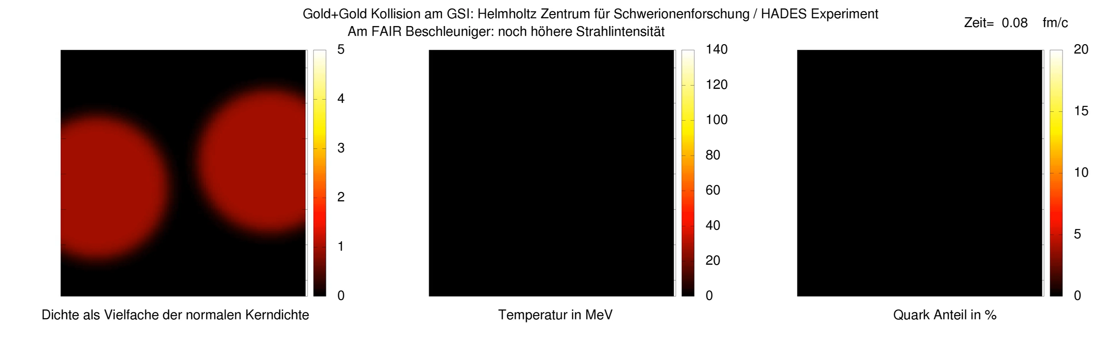
The EoS in (heavy-ion) action
Au+Au collision at SIS18 energies (1.23 AGeV)
time
baryon density [ρ₀]
temperature [MeV]
quark fraction (%)
J. Steinheimer

Slide 31
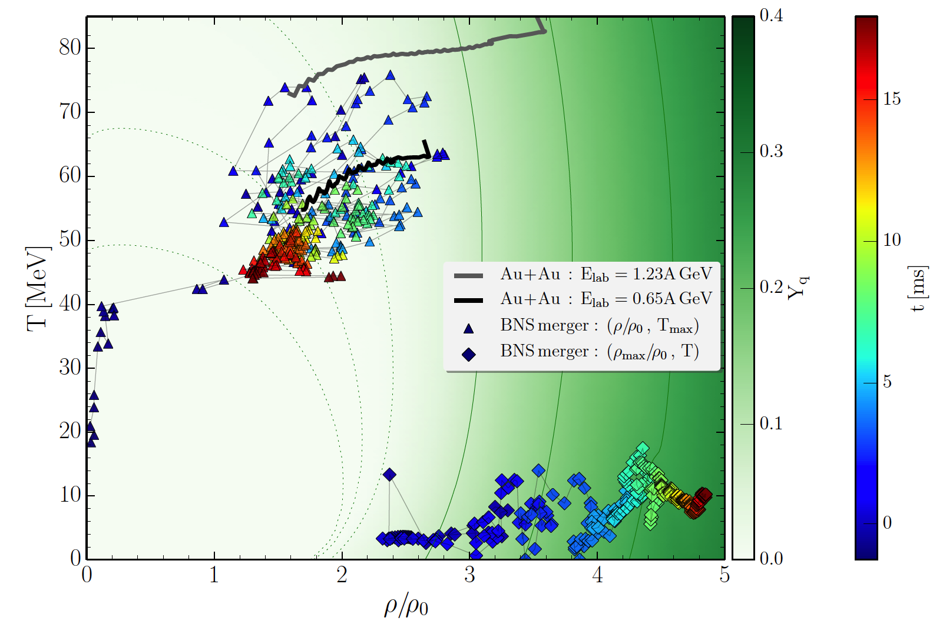
evolution of central cell in hydro simulation in (ρ,T) plane
compared to merger results
max. temperature
max. density

Slide 32
Conclusions
heavy compact stars / hyper stars - little strangeness
hybrid stars: stiff equation of state for quarks? lattice susceptibilities
large mixed phase in hybrid star
EoS in HI / merger simulations
rotation/magnetic fields remove quark core
mergers evidence for smaller stellar radii and „small“ maximum masses
consequences for the equation of state
isospin-dependent nonlinearities
low slope parameter / affects drip line
exotic matter via mixed phase (ok with lattice)
hopefully more merger events, exploit relation to heavy-ion physics

Slide 33

Condensation of charged higher spin bosons?
Heavy-ion collisions can generate very large B fields
W boson condensation at LHC? Ambjørn, Olesen,PLB257, 201 (1991)
however, see SWS, Müller, A. Schramm, PLB 277, 512 (1992)
ρ mesons? Simple estimate requires B ~ 10²⁰ G
SWS, Müller, A. Schramm MPLA 7, 9773 (1992)
heavy-ion collisions – bind away the whole mass of the particle
Chernodub, Phys. Rev. Lett. 106, 142003
Hidaka, Yamamoto PRD87, 094502
Advantage: high spin – strong interaction with magnetic field
Landau levels of the rho meson
E²_{n,Sz} = p² + m² + (2 n- 2 S_{z} + 1) e B

Slide 34
CMF - hadronic SU(3) approach based on non-linear realization of σω model
Lowest multiplets
B = { p , n , Λ , Σ^{±/0} , Χ^{-/0} }
baryons
diag (V) = { (ω + ρ) / √2 , (ω - ρ) / √2 , ϕ }
vector mesons
diag (X) = { (σ + δ ) / √2 , (σ - δ) / √2 , ς }
scalar mesons
Mean fields generate masses, scalar attraction and vector repulsion
L_{BW} = - √2 g₈^{W} ( α_{W} [BOBW]_{F} + (1 – α_{W}) [BOBW]_{D})
- g₁^{W} / √3 Tr(BOB) Tr (W)
SU(3) interaction
_
V(M) <σ> = σ₀ ≠ 0 <ζ> = ζ₀ ≠ 0
_
_
_
_
_
σ ~ <u u + d d> ζ ~ <s s> δ⁰ ~ < u u - d d>
plus explicit symmetry breaking

Slide 35
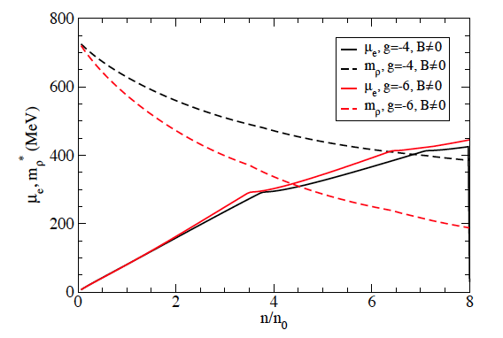
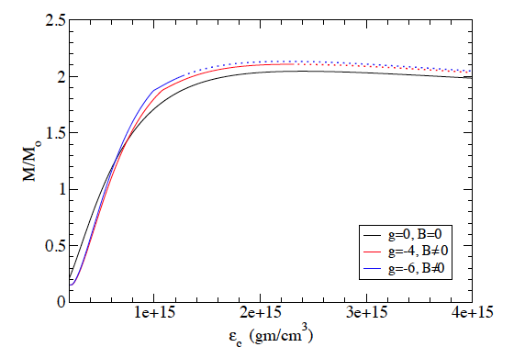
charge chemical potential and effective rho mass as function of density
magnetars with surface fields
up to 10¹⁵ G
Use standard hadronic model
GM3 parameterization
B value: 7 × 10¹⁸ G
condensation
slight change of star masses
faster cooling
density dependence of rho mass ?
simple estimate m_{ρ}* = m_{ρ} - g σ
readjust g_{Nρ} to correct
asymmetry energy a_{sym}
range of g limited by slope of a_{sym}(ρ)
Mallick,Dexheimer,SWS,Bhattacharyya, MNRAS (2015)
first: Voskresensky PLB 1997
Kolomeitsev,Voskresensky NPA 2005
onset of condensation

Slide 36
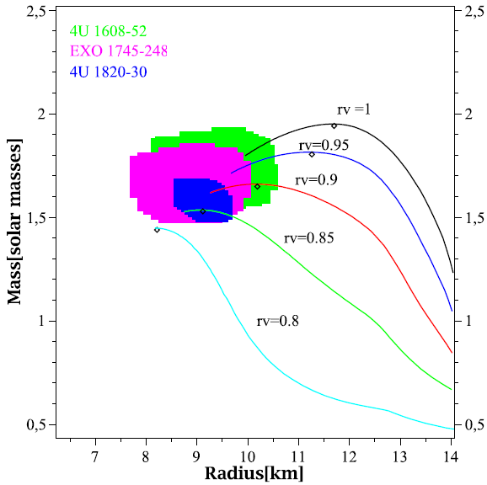
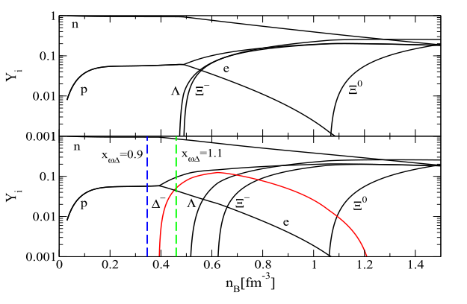
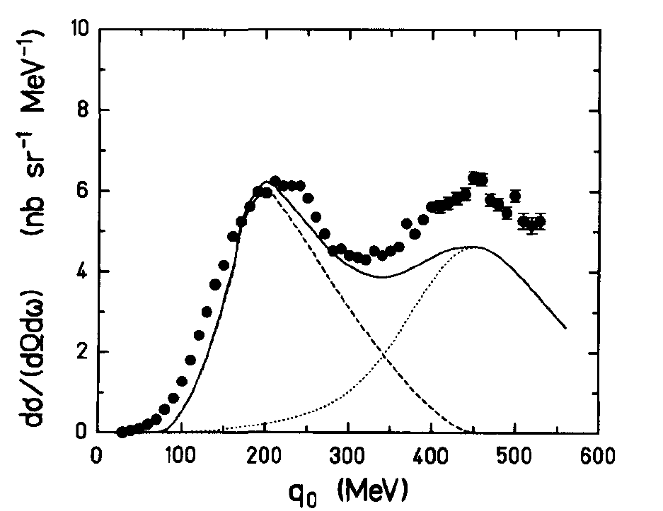
Δ baryons in compact stars?
Özel et al, Phys.Rev.D82:101301,2010
Δ resonances
scalar couplings vacuum masses
vector couplings unclear
moderate changes r_{V} = g_{Δω} / g_{nω}
not far from SU(6)
constraints from πA scattering
photoabsorbtion
Schürhoff, SWS, Dexheimer, APJL 724 (2010) L74
x_{ωΔ} = r_{v}
quasielastic eA scattering
E_{e} = 695 MeV ⁴⁰Ca
g_{Δσ} / g_{Nσ} = 1
1.2
analysis in Drago et al astro-ph:1407.2843:
Onset of Δ population at 2 to 3 ρ_{o}
Wehrberger, Phys. Rep. 225, 273 (1993)
Quark star and Δ star families

Slide 37
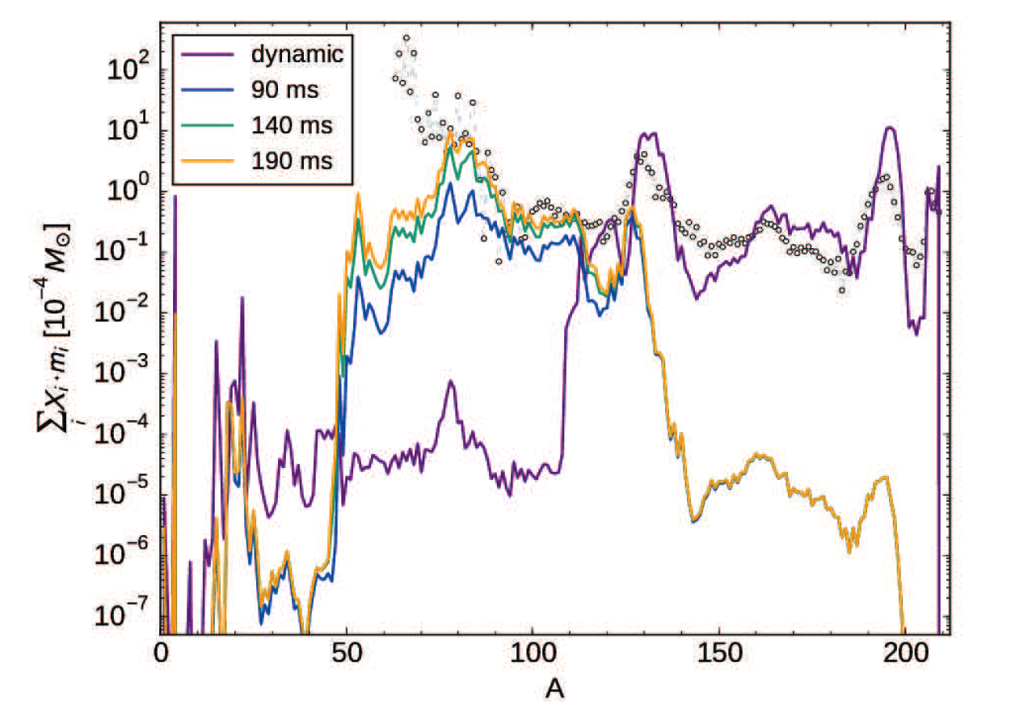
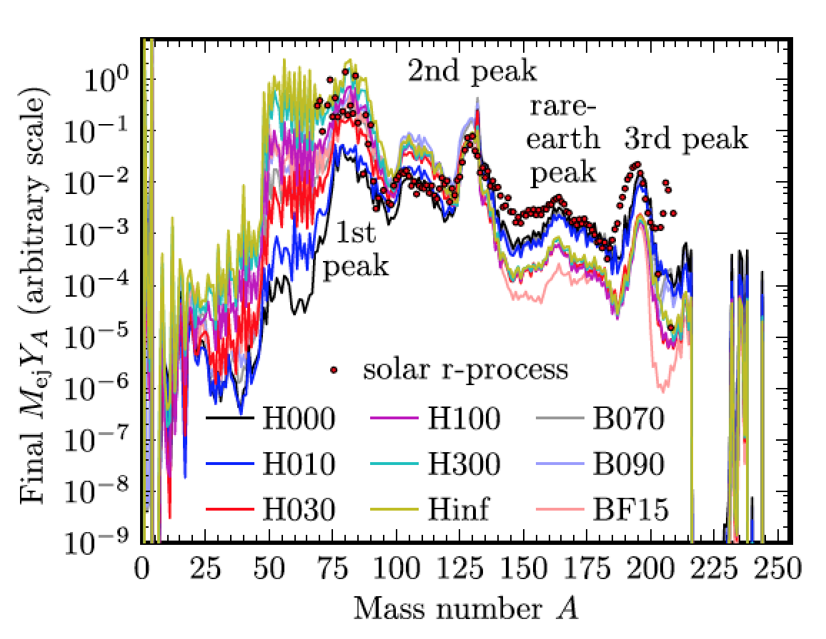
results from r-process
network calculations
dynamic ejecta, neutrino wind
from Thielemann et al, arXiv:1710.02142
Lippuner et al, MNRAS 472, 904–918 (2017)
overall, r-process might be covered by merger events
what about the original supernova explosions?

Slide 38


phase structure for different values of 𝜇_{S}
critical end point
first order transition vanishes
Mukherjee Bhattacharyya, SWS, in prep.

Slide 39


parameters fine-tuned
to lattice results
susceptibilities
interaction measure
Motornenko et al, in prep.

Slide 40


most “basic“ neutron star
core consists of neutrons, protons, electrons, muons
for the static non-magnetized star:
solve Tolman-Oppenheimer-Volkoff equations
requires equation of state for dense (warm) matter
non-relativistic descriptions
Skyrme mean field (SLy, SkM, SKA, ...), variational calculations,
relativistic models, mean-field models of „Walecka“ type
Dirac equation for nucleons plus mean fields for mesons

Slide 41
neutron star mergers as source of heavy elements
Long-standing idea that r-process nuclei are generated in merger events
Lattimer, Schramm, ApJ (1974, 1976)
Freiburghaus, Rosswog, Thielemann, ApJ (1999)
r-process material generated in different parts of the merger
Dynamical ejecta
Neutrino wind
Accretion disk
Neutron star merger generates
gravitational wave signal
short 𝛄 ray burst
optical transient (kilonova)

Slide 42



signs of vector repulsion in T_{c}(μ) behavior
curvature κ = -T_{c} dT_{c}(μ)/dμ²|_{μ=0}
plot taken from
Bratovic et al, PLB 719, 131 (2013)
results of
PNJL calculation
Lattice: Kacmarek et al
PRD 83, 014504 (2011)
large quark
vector repulsion?
turn on/off repulsion
of quarks and baryons
quark interaction should be small
in the hadron sector either heavy baryons and/or repulsion (liquid-gas, nuclei)
Steinheimer,SWS,PLB 736,241

Slide 43
Nuclear Matter and Nuclei
binding energy E/A ~ -15.2 MeV saturation (ρ_{B})₀ ~ .16/fm³
compressibility ~ 223 MeV
asymmetry energy ~ 31.9 MeV
parameter fit to known nuclear binding energies and hadron masses
2d calculation of all measured (~ 800) even-even nuclei
older results: error in energy ε (A > 50) ~ 0.17 %
ε (A > 100) ~ 0.12 %
+ correct binding energies of hypernuclei, reasonable charge radii
new fit in the works – requires parameter fine-tuning
combine with crust simulations
SWS, Phys. Rev. C66, 064310

