Slide 1



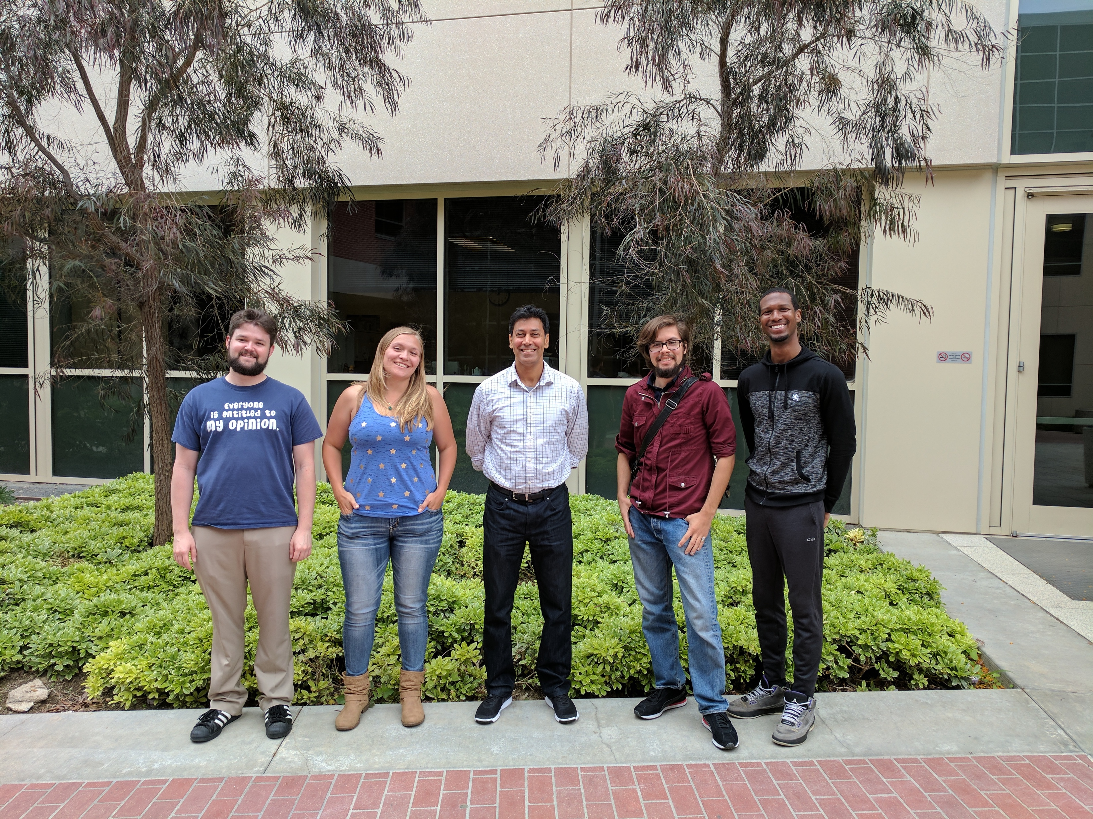

effects of quark matter on non-radial Oscillations of compact stars
Graduate Center/ CUNY | CSQCD-VII | June 11-15, 2018
Prashanth Jaikumar, CSU Long Beach
Collaborators: Wei Wei (Huazhong Agricultural U.), Gautam Rupak (Mississippi State),
Thomas Klaehn (CSU Long Beach), Cesar Vasquez (U.ABC, Brazil)
Students: Nina Miller, Ben Diaz, Raphael Monroy, Michael Lanoye, Megan Barry

Slide 2
Outline
Motivation: Stellar Oscillations and Gravitational Waves
Pedagogy: Newtonian/General Relativistic Approach
Methods: Chandrasekhar-Ferrari-Zerilli Equations
EOS: Neutron/Hybrid/Quark
Results: Effects of Strange Matter on the Eigenspectrum

Slide 3

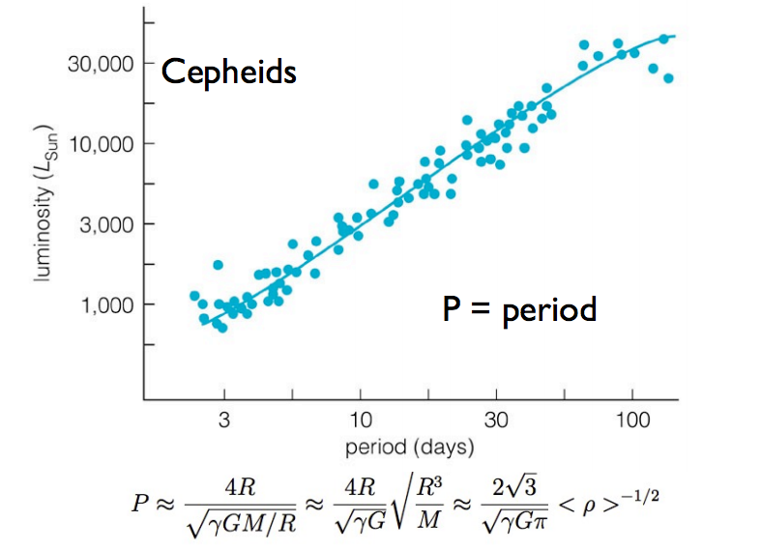
STELLAR OSCILLATIONS
Dynamo origin of solar magnetic field (Provided proof for differential rotation in the Sun)
2. Verified age of Sun ~ 4.6 billion yrs
(sound speed depends on He/H ratio)
3. Pointed to neutrino oscillations
(Ruled out solar physics solution to the neutrino problem)
(ACOUSTIC)
(OPTICAL)
Non-adiabatic radial oscillations
Change of Ionization state drives pulsations
HeI HeII
(less opaque) (more opaque)
Variable stars serve as standard
Standard Candle for Extra-galactic scales on the Cosmic distance ladder
Notes:
P-modes in convection zone, g-modes in core (radiation zone). Seen by Doppler shift of spectral absorption lines as gas pulsates.

Slide 4
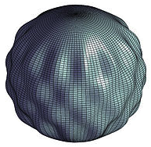
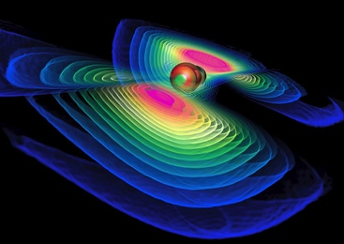
Gravitational Waves from Compact Stars
Non-Radial Oscillations
  Spherical shape of the star is not
  preserved.
  Quadrupolar Oscillations couple to
  Gravitational Waves
  Spectrum of oscillations depends on
  internal composition of neutron stars.
24

Slide 5
TYPES OF MODES
 | Restoring force | Typical freq. | Stellar property probed
f | (Surface) Gravity | 1 - 3 kHz | Mean Density
p | Pressure | 6 - 10 kHz | Sound speed
g | Buoyancy | 0.1 – 1 Hz | Chemical gradient
s , i | Shear forces between layers | 1 – 10 Hz | Shear modulus
r | Coriolis | 0.1 – 1 kHz | Viscosity

Slide 6
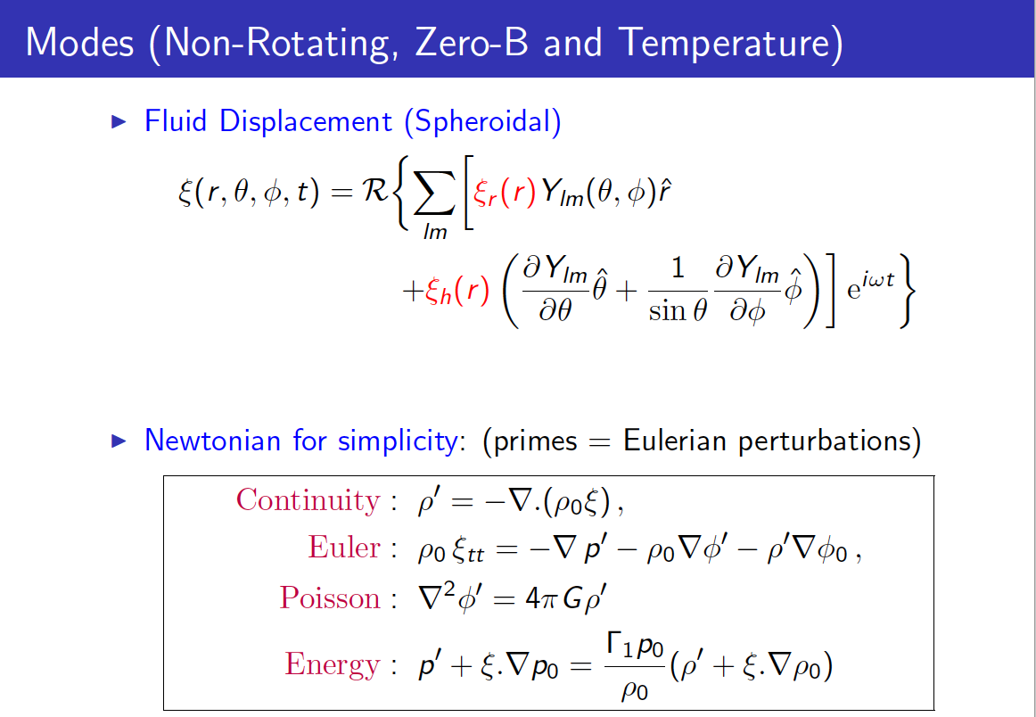
Newtonian gravity

Slide 7
(Cowling Approximation)

Slide 8
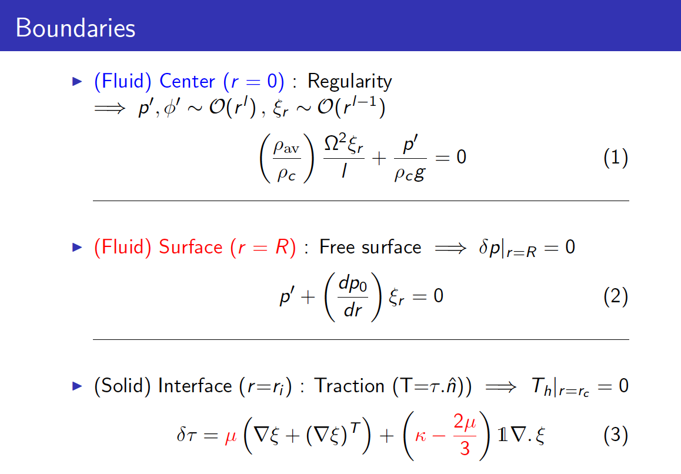

Slide 9
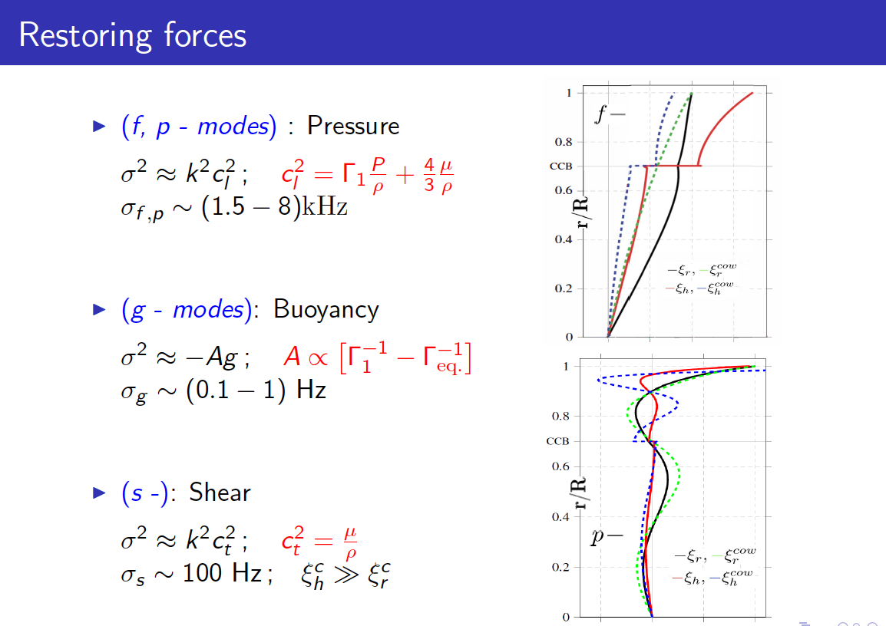

Slide 10


General relativity
Spherically Symmetric Background: Schwarzschild Metric
Metric perturbations

Slide 11
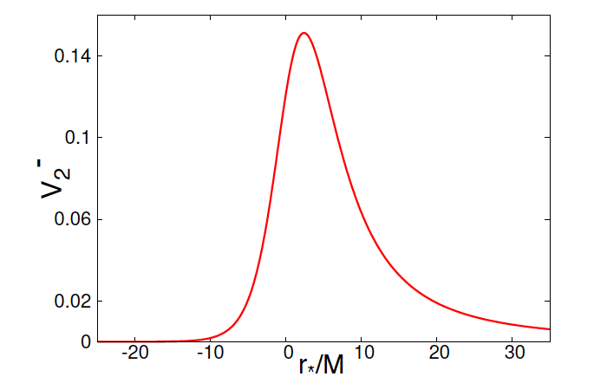
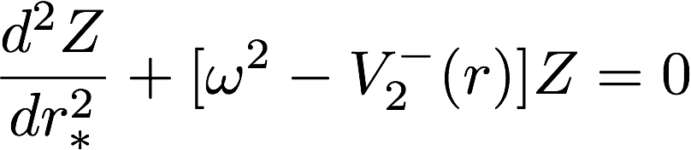
Axial modes of black holes
Chandrasekhar and Detweiler (1975):
- radial part of the perturbation equation is a Schrodinger equation
Zerilli Equation:
Finding Quasi-Normal Modes =>
Solving 1D Schrodinger equation for scattering from a central potential
Various Methods : Resonances, WKB, Continued Fraction

Slide 12

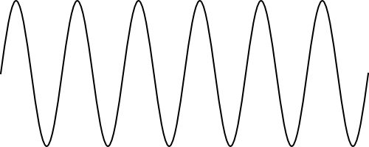
Polar modes of compact stars
Zerilli Equation :
Chandrasekhar & Ferrari : metric perturbations decouple from fluid perturbations;
Once former is known inside the star, the latter follows from algebraic relations!
Incoming
Outgoing
Quasi-normal modes of star <=> Resonance state of 1D potential

Slide 13

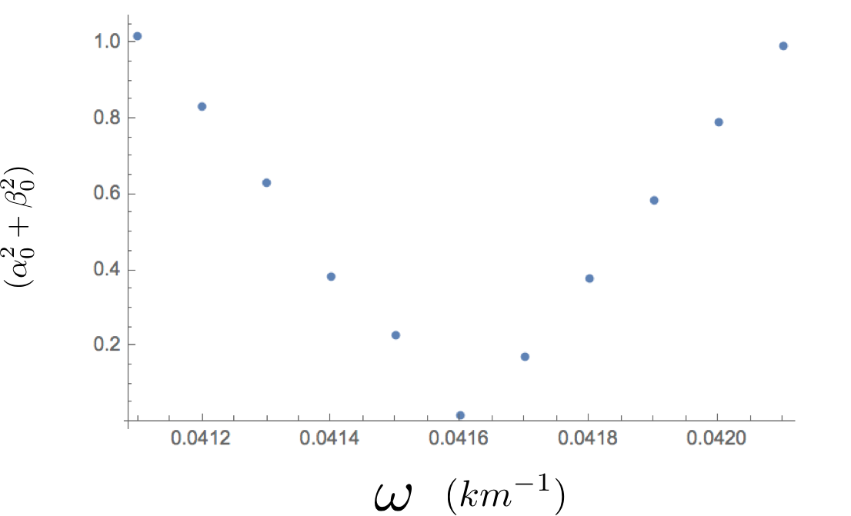
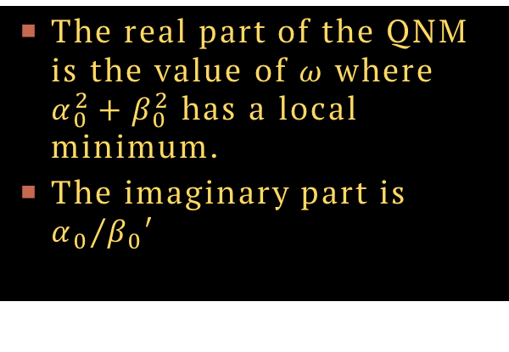
Finding the quasi-normal modes
The real part of the QNM is the value of 𝜔 where $α_{0}^{2}+β_{0}^{2}$ has a local minimum.
The imaginary part is ${α_{0}}/{β_{0}′}$

Slide 14
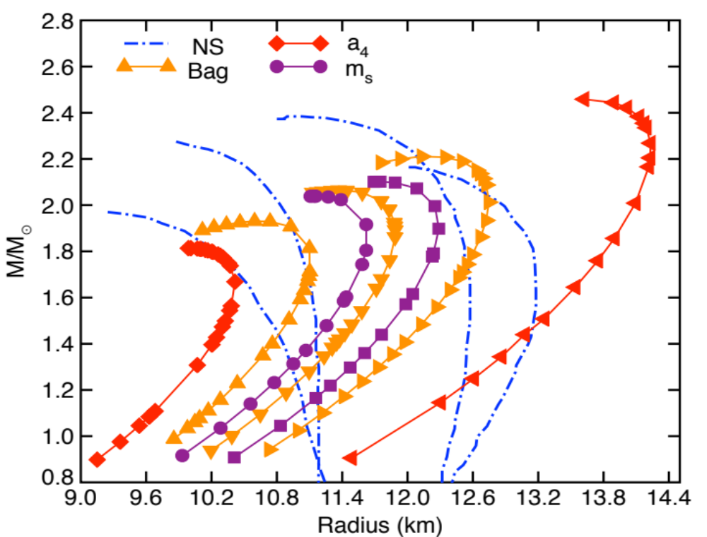
Stellar Structure
Neutron/Strange stars can have similar mass and radius
(a4: Transition density fixed, B is effectively renormalized)
  NS EoS
  apr, bsk19,bsk21,wff2
  Lattimer & Prakash (2001);
  Ozel & Friere (2017)
  QS EOS (Alford et al. 2005)
  B = 41, 48, 56 MeV/fm³
  m_{s} = 50, 150 MeV
  a₄ = 0.5, 0.9
Notes:
The SQS EoS is still viable since it agrees with the bounds of observed radii of neutron stars.
Now that we have set up our model we can now study the non-radial oscillations of the fluid in these two categories of stars using general relativity.
Given uncertainty in the exact parameters of qm you cannot distinguish between the stars with MR curves alone.

Slide 15
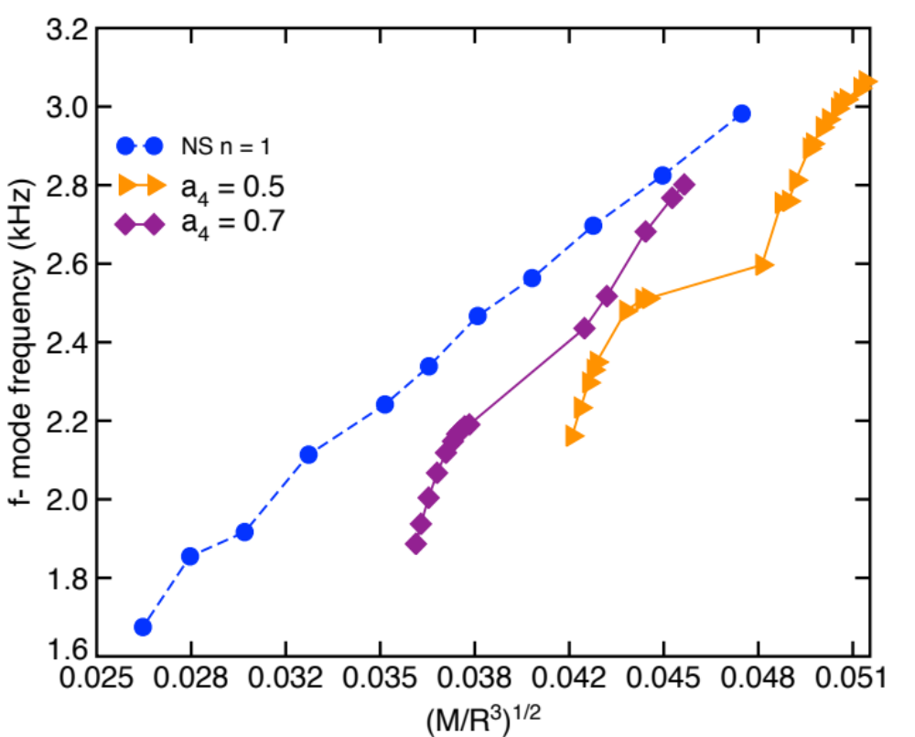
Scaling relations : F-mode
Variable: QCD Interaction Parameter
a4 varied;
B and ms fixed
Smaller a4
lower quark pressure
Higher mean density

Slide 16
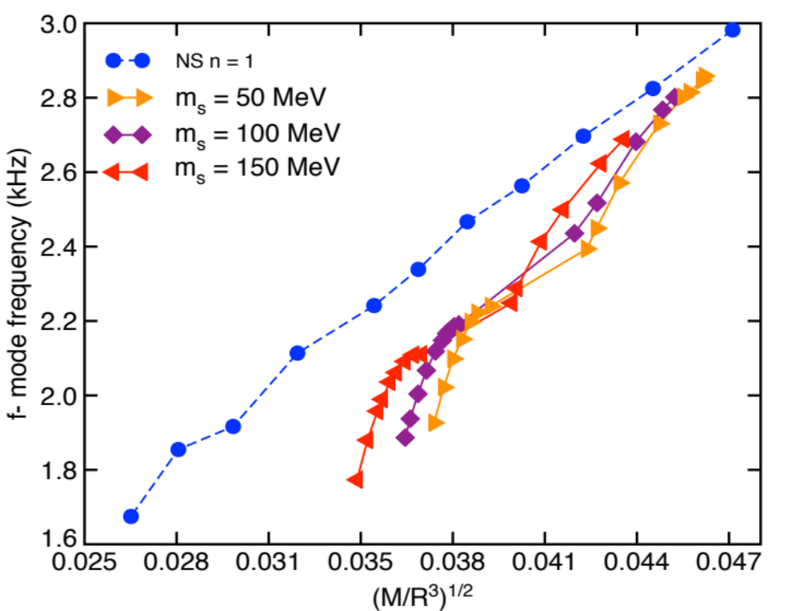
Scaling relations : F-mode
Variable: Strange Quark Mass

Slide 17
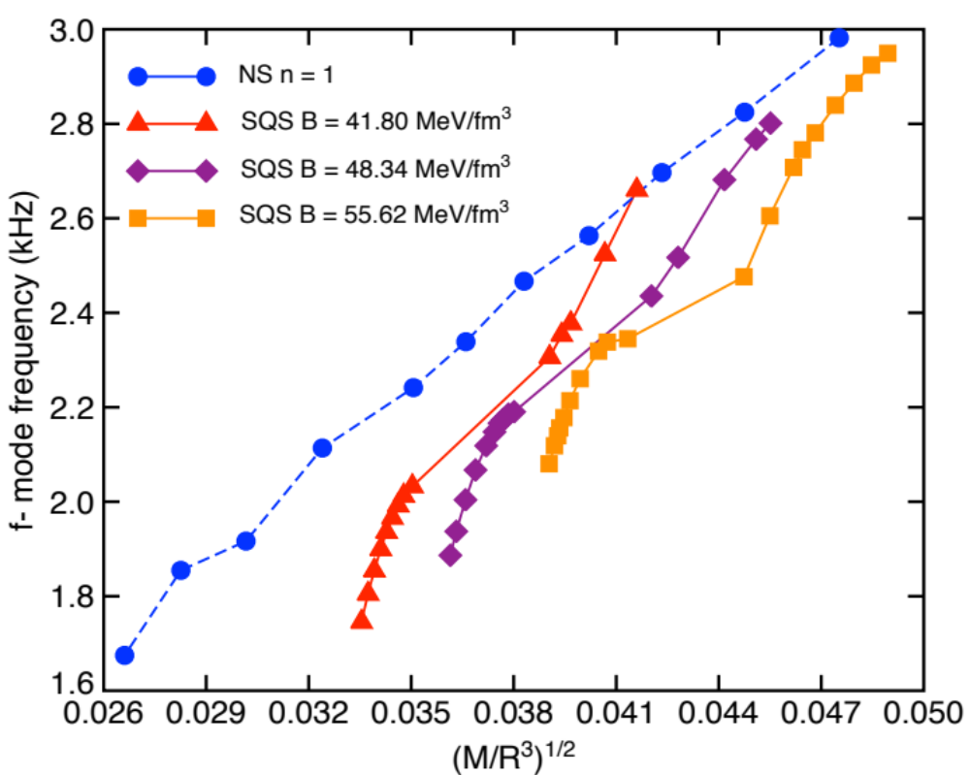
Scaling relations : F-mode
Variable: Bag Constant

Slide 18
Scaling relations : F-mode frequency
QCD Interaction Parameter
Strange Quark Mass
Bag Constant
f-mode frequencies proportional to the mean density
Even a rough estimate of the f- mode frequency constrains the mean density

Slide 19

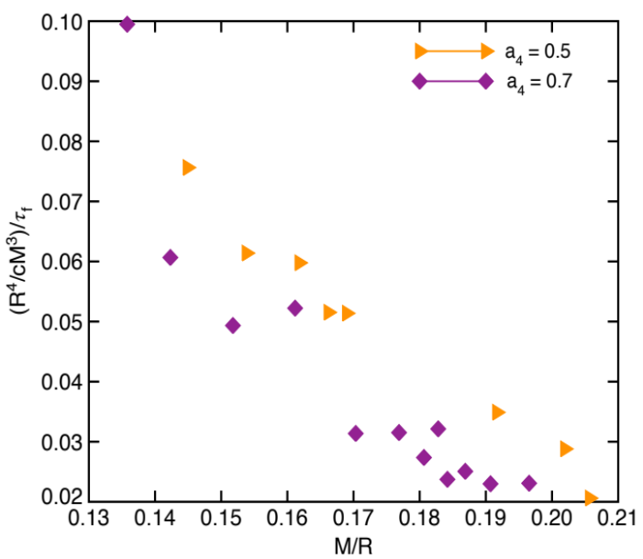
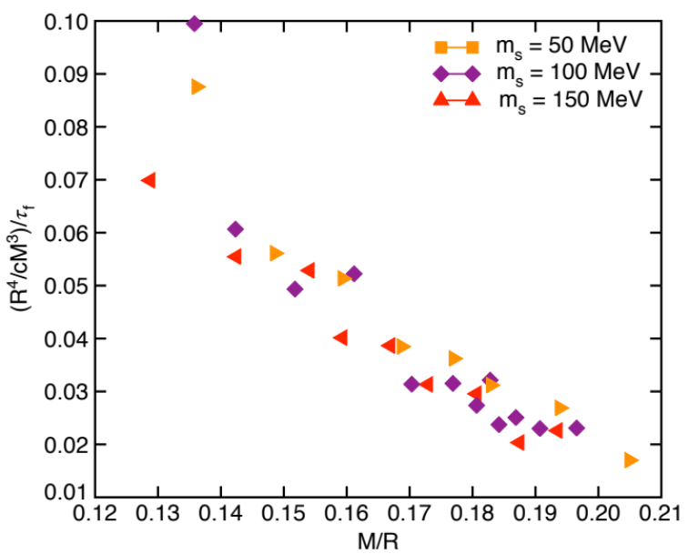
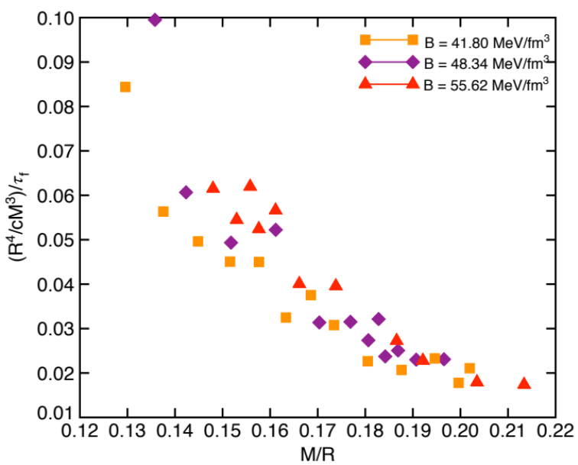
Scaling relations : f-mode damping
Time needed for a fraction of energy to transform to gravitational radiation.
~ 0.1 - 1 sec
QCD Interaction Parameter
Bag Constant
Strange Quark Mass

Slide 20
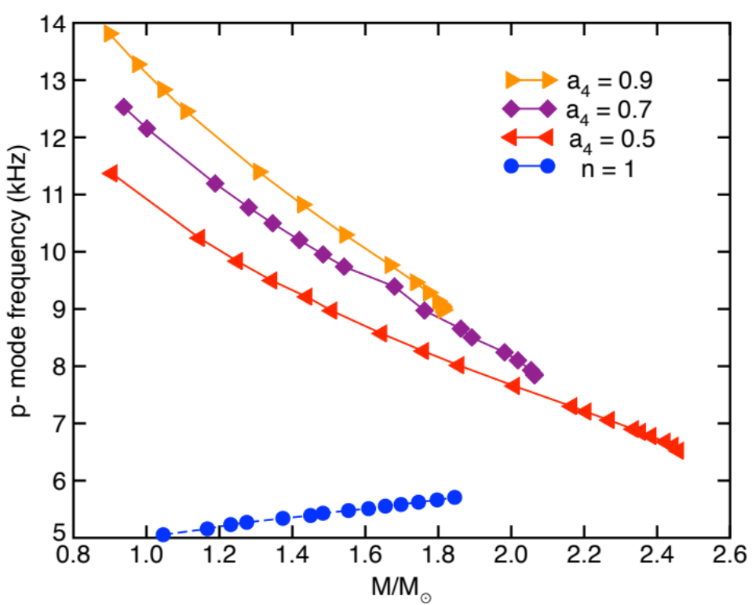
Scaling relations : P-mode
Self-bound stars dM/dR behaves opposite to NS
Variable: QCD Interaction Parameter
a4 varied;
B and ms fixed
Smaller a4
Lower pressure
Lower p-mode frequency

Slide 21
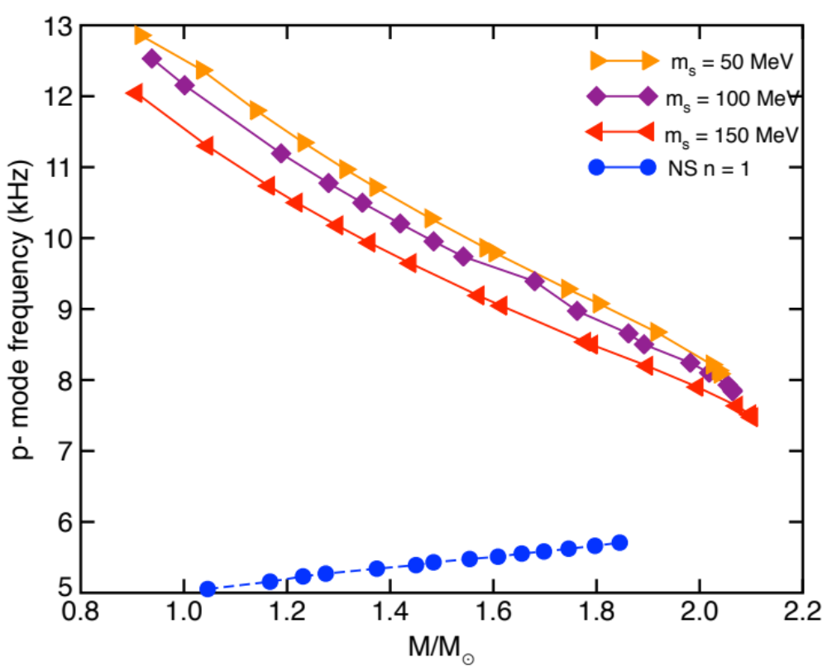
Scaling relations : p-mode
Variable: Strange Quark Mass

Slide 22
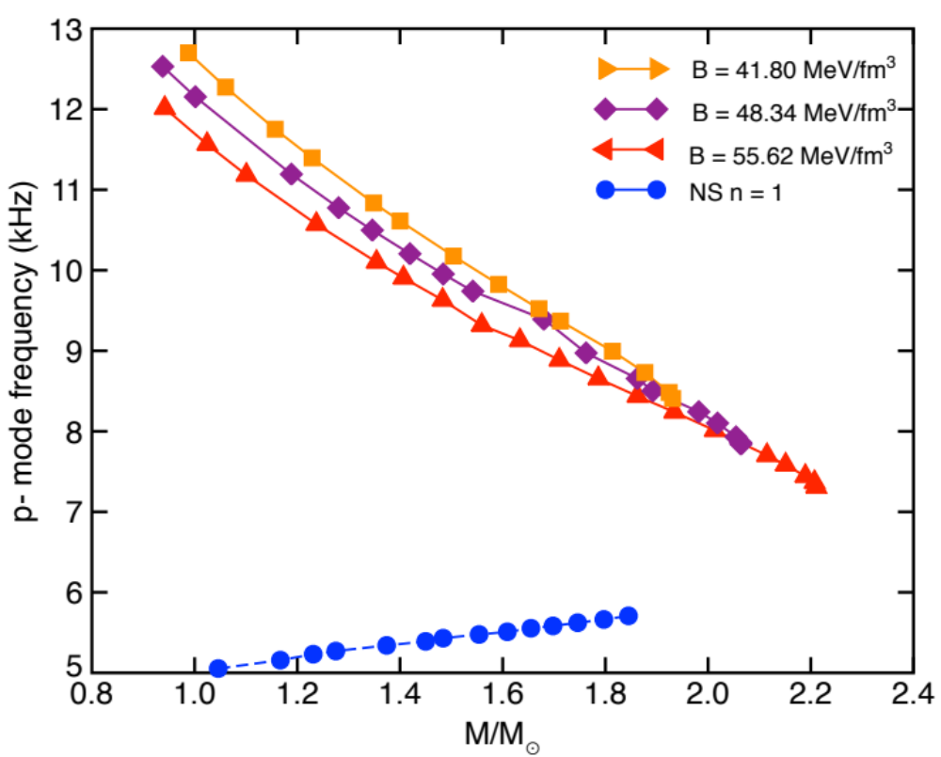
Scaling relations : P-mode
Variable: Bag Constant

Slide 23
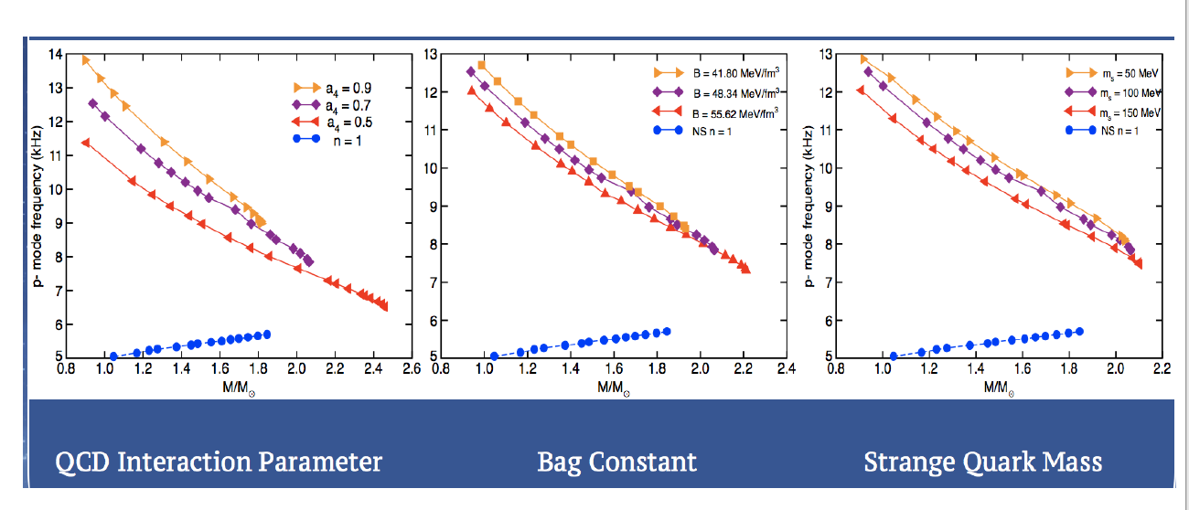
Scaling relations : p-mode freQ uency

Slide 24
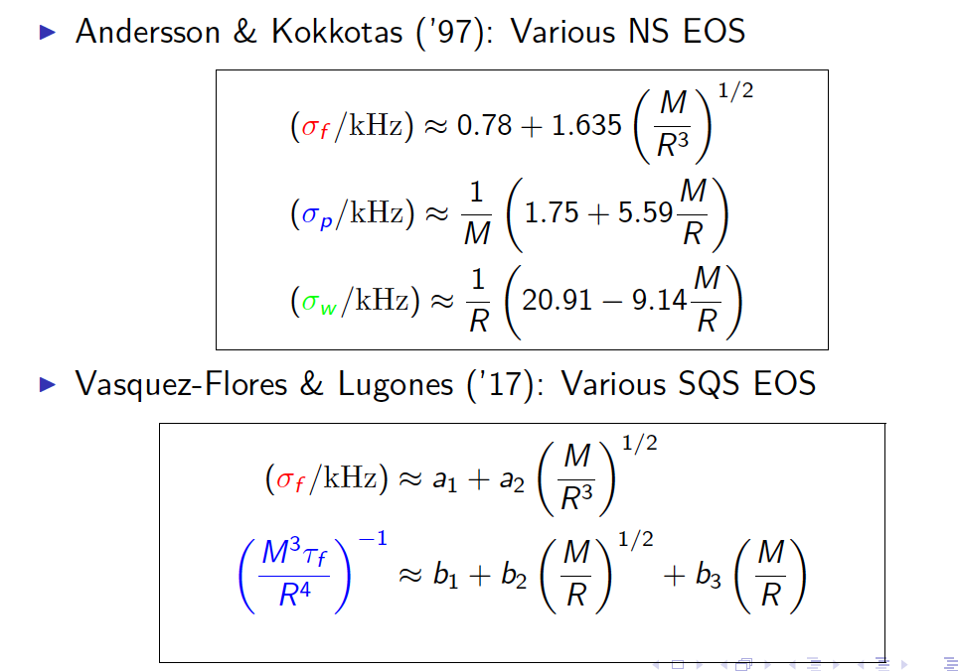
Scaling relations

Slide 25
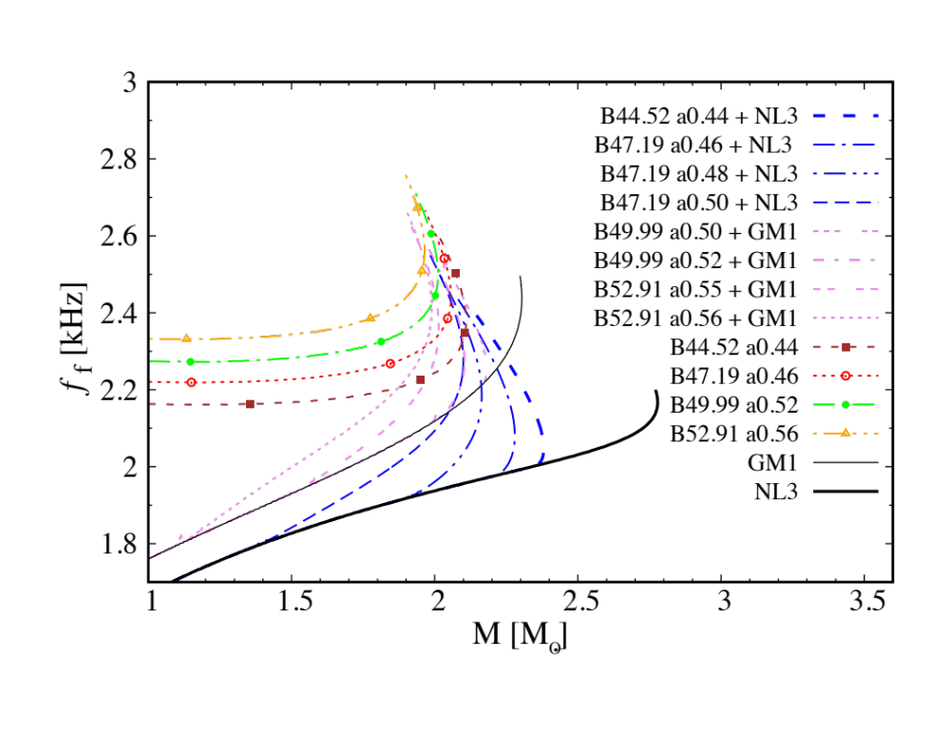
f-mode : neutron matter vs quark matter
f-mode frequencies approximately
constant for pure quark matter up
to 1.8 Msun
Detection in AdLIGO would support
Neutron/Hybrid stars
Detection in Schenberg/Mini-Grail
would support some fraction of
quark matter in neutron stars
Vasquez, Hall & Jaikumar, Phys. Rev. C 96, 065803 (2017)

Slide 26
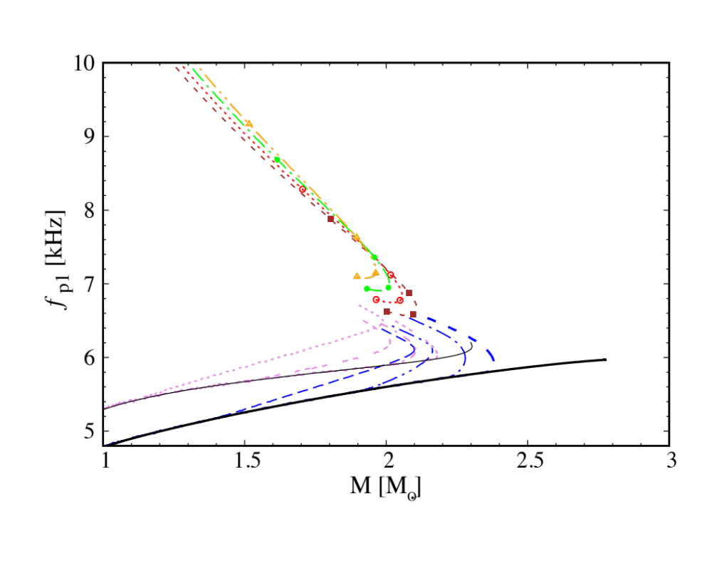
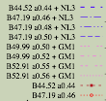

P-mode : neutron matter vs quark matter
If only f-modes are detected, we can
constrain mean density but not EoS
With p-mode frequencies detected,
we can invert scaling relations to
find M, R separately,
Useful to constrain EoS.
However, p-mode frequencies for
quark/neutron stars are beyond reach
of current detectors
C. Vasquez & P. Jaikumar, Phys. Rev. C 96, 065803 (2017)

Slide 27
conclusions/discussion
Non-radial modes of compact stars show sensitivity to EOS, other fluid properties
Approximate scaling relations can be derived for f, p - modes
Interfacial (i-), shear (s-) or stratification (g-) modes can probe phase boundaries/crusts
Mechanism for large amplitude excitations is not known
(saturation due to bulk and shear viscosity is particularly strong for p-modes)
Modes of PNS (non-zero T) and post-merger hypermassive NS (rotation complicates!)
Pre-merger NS (tidal forces induce oscillations) => background is deformed

Slide 28

Thank you!

Slide 29
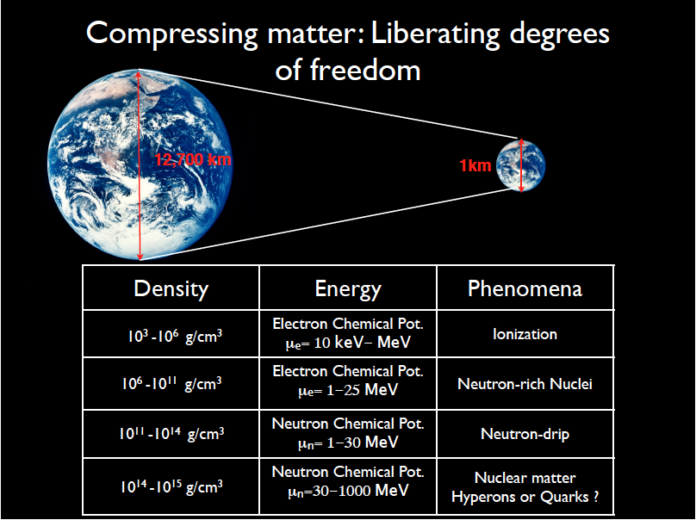
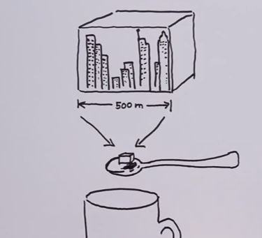

Slide 33
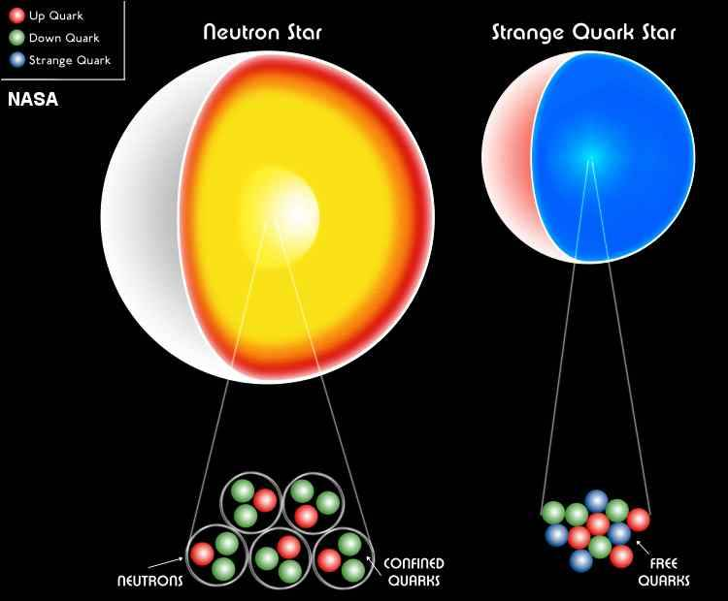

Slide 34
Strange Quark Matter Hypothesis
Bodmer ‘71, Terezawa ‘79, Witten ‘84
E/A (MeV/n)
hyperon
Λ~1115
Hyper nuclei
⁴¹Ca_{Λ} ~ 958
939
nucleon
~ 930
~ (900-920)
Fe nuclei
Strange Nugget
n_{s}/n_{B}

Slide 35
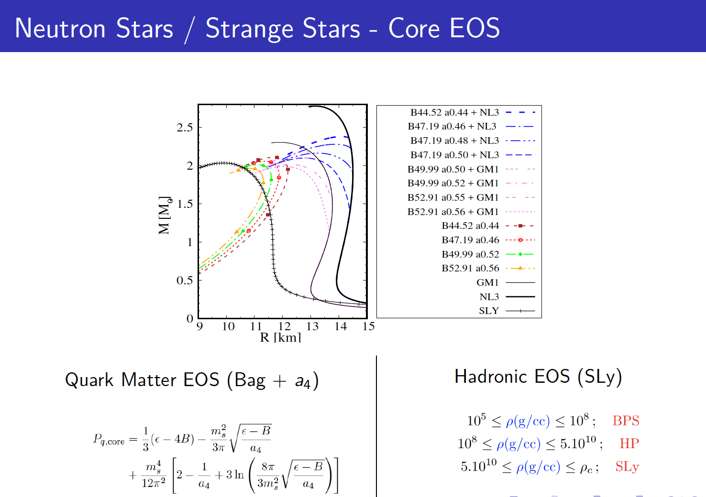
Equations of State
Notes:
Simple relativistic massless gas. Place the quarks into a potential well. keeps them from escaping to infinitiy.
adding the second term increases the maximum mass

Slide 36

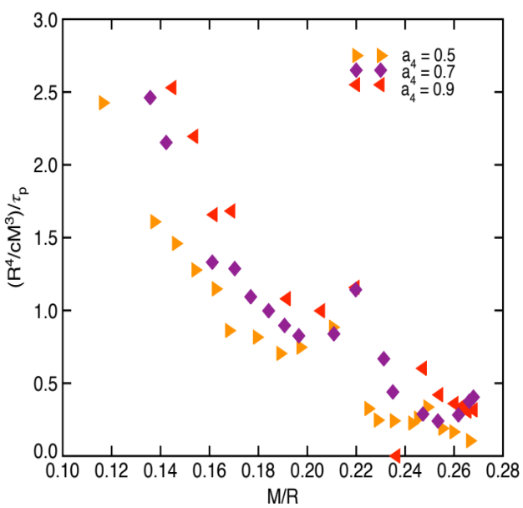
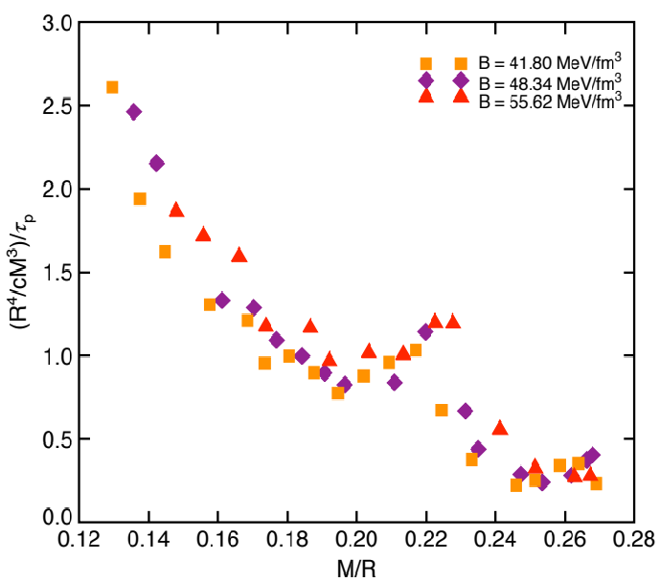
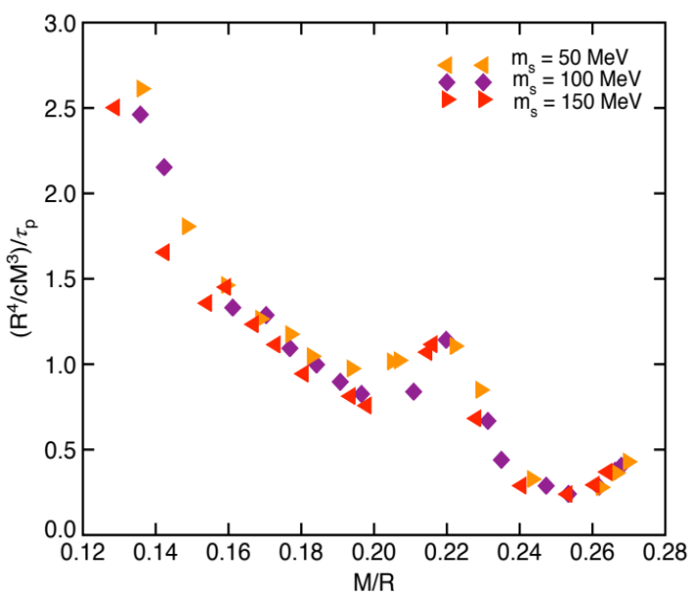
Scaling relations : p-mode damping
Time needed for a fraction of energy to transform to gravitational radiation.
p- modes are associated with the local sound speed
QCD Interaction Parameter
Bag Constant
Strange Quark Mass

Slide 37

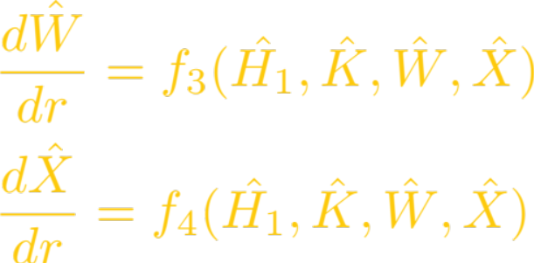
Polar modes of compact stars
Metric :
Fluid :
Only outgoing waves at infinity
X = 0 at the surface of the star
All variables are regular at r = 0

Slide 38
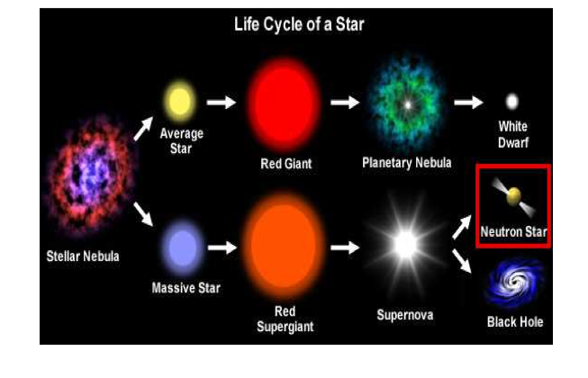
The birth of a neutron star

Slide 39
CAN WE USE GRAVITATIONAL WAVES
TO LOOK INTO THE DEPTHS OF A NEUTRON STAR?

Slide 40

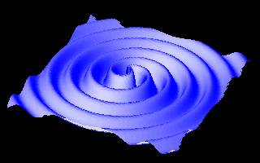
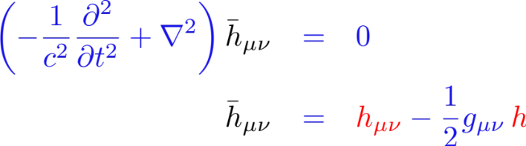
NEUTRON STARS (GRAVITATIONAL)
First detection of Black Hole merger
Bound on graviton mass
GR verified up to 100 km scales
First detection of binary NS merger
Photodetection of differential
strain produced by passing
gravitational wave
SNR ~ 24, 5.1𝜎 detection
GW150914, (GW151216)
36+29 Solar Masses
L_{peak} ~ 3.6 x 10⁵⁶ ergs
Orbital distance 350 km
Speed (0.3 - 0.6) c

Slide 41
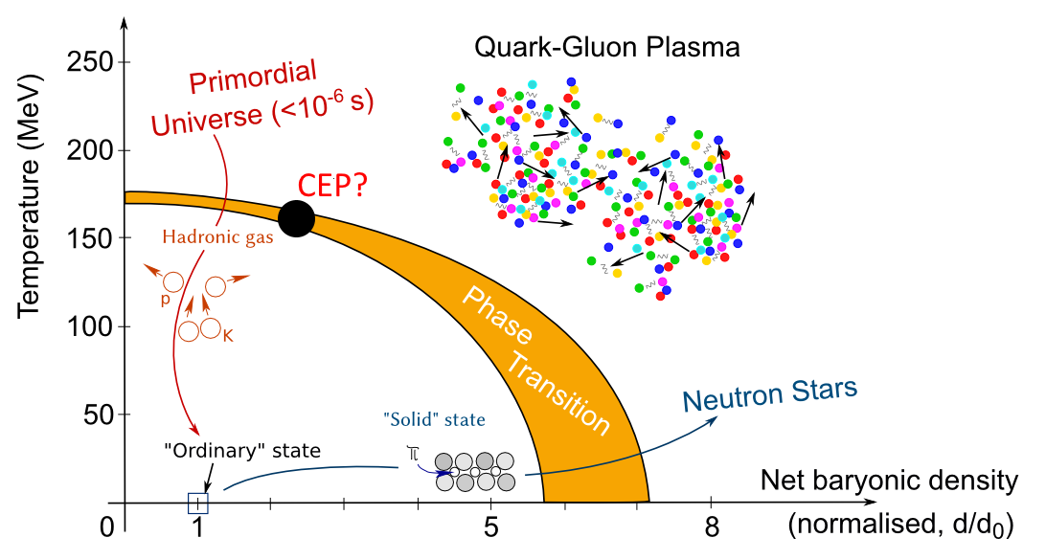
QCD Phase DIAGRAM
Lattice Simulations do not apply;
Need models of Dense Matter
© 2011 CERN – Antonin Maire

Slide 42
SOLAR OSCILLATIONS (ACOUSTIC)
Helioseismology – study of oscillations in the Sun
(5 minute oscillations discovered by R. Leighton et al., 1960)
1. Provided proof for differential rotation in the Sun
2. Constrains Opacity profile in convection zone
(infer solar system element abundances)
3. Ruled out solar physics solution to the neutrino problem
(pointed to neutrino oscillations)

Slide 43
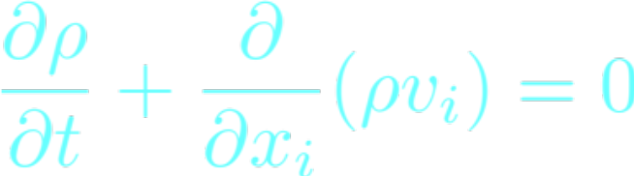
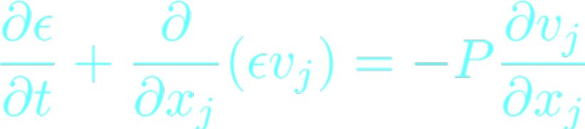
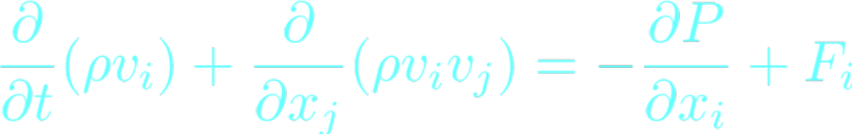
Equations of Stellar Pulsation
Neutron star matter as an ideal fluid
Perturb Euler equations
ρ = mass density
ρv_{i} = momentum density
ε = internal energy
ρv_{i}v_{j} = momentum flux
F_{i} is the restoring force.
25

Slide 44
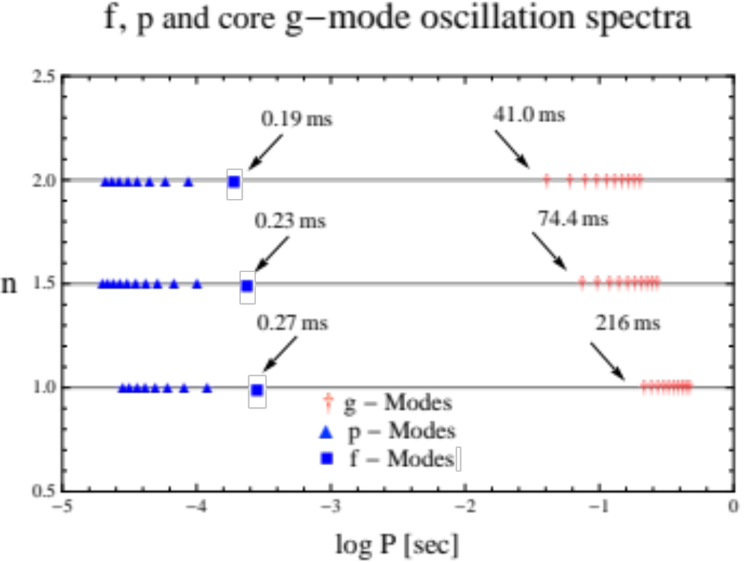
Newtonian gravity
One-Component (fluid only) Neutron Star.
Asbell & Jaikumar,
Proceedings of CSQCD V (2017)

Slide 45


BACKGROUND FLUID
Perfect fluid
Bianchi Identities
Relativistic Euler Equations : 4 equations, 5 unknowns
Equation of State : p = p (ε, Y_{a})
Conservation of Baryon current :
Locally Co-Moving Inertial Frame
Thermodynamics

Slide 46
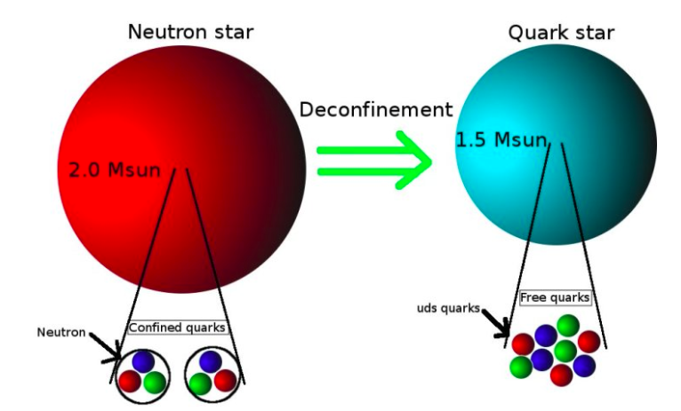
Equation of state (EOS)

Slide 47
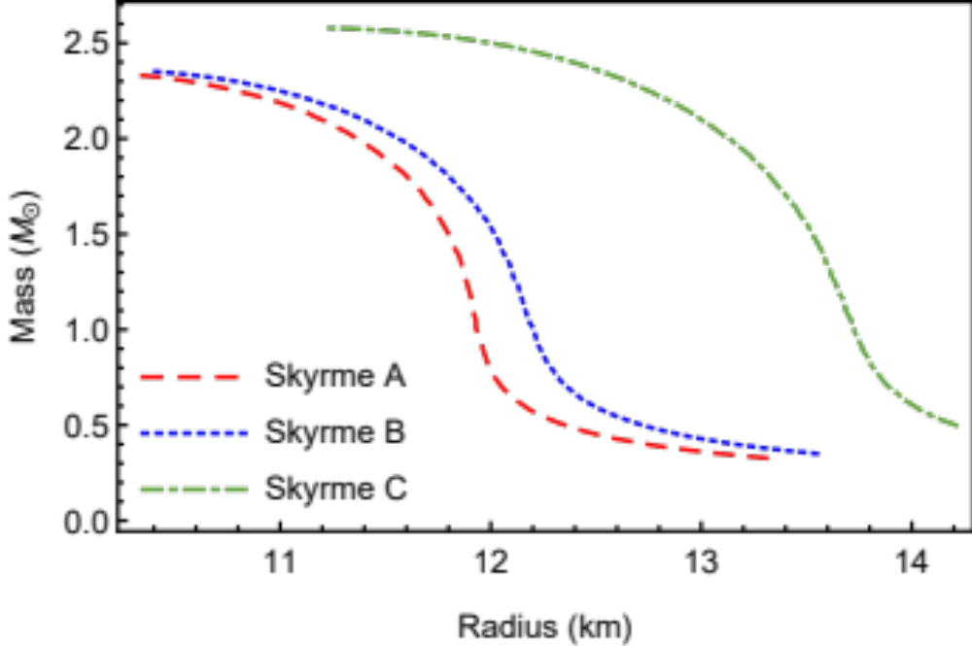
Typical neutron star EOS
Jaikumar, Monroy and Klaehn, Universe (2018) 53, 4.

Slide 48
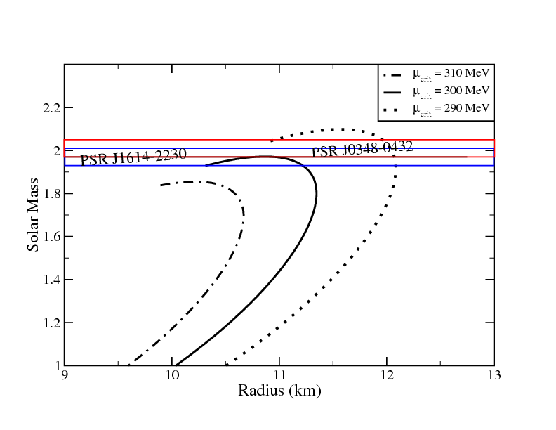
Typical quark star eos
C. Vasquez, Z. Hall & P. Jaikumar, Phys. Rev. C 96, 065803 (2017)

Slide 49
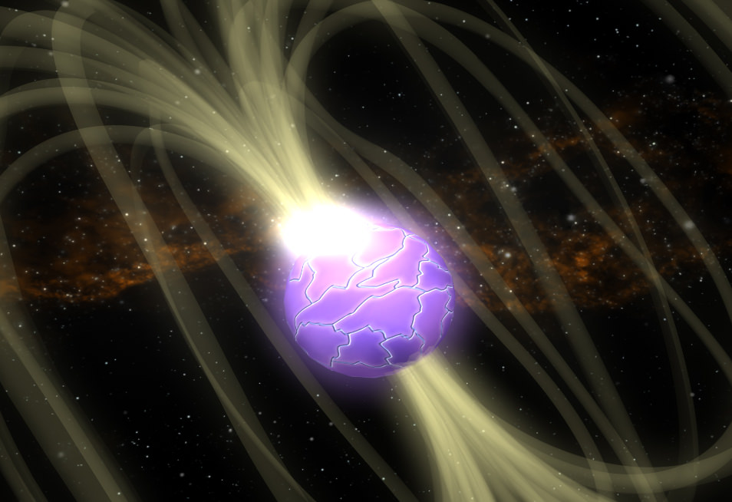
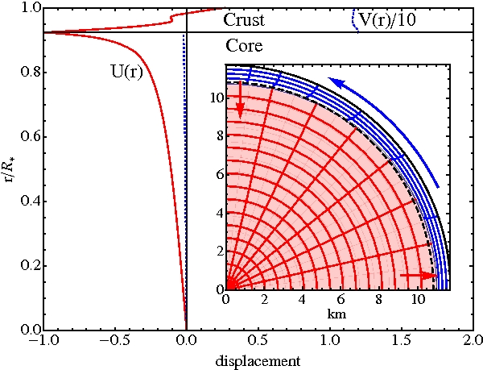
Localized modes – crust (I-MODE)
Resonant shattering of neutron star crust,
driven by tidal interactions in a binary system
Interface or i-mode has period ~ 100 ms
Tsang et al., PRL 108, 011102 (2012)
Neutron star crust is billion times
stronger than steel!
Deformations are small but can
happen as stresses build over time

Slide 50
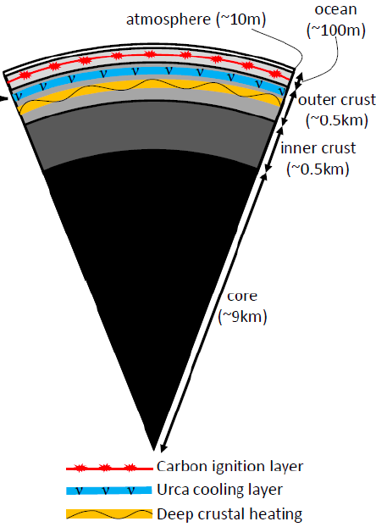
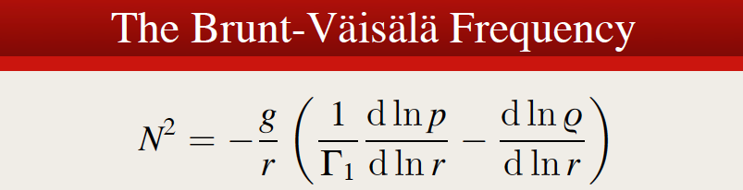

Surface (Ocean) g-Modes
(Accreting neutron stars)
Surface g-modes within a Carbon-rich
ocean in Neutron Stars.
Asbell & Jaikumar,
Proceedings of CSQCD V (2017)

