Slide 1
Rotational configuration of quark stars and their impact on post-merger behaviors
Enping Zhou
Peking University
Advisor: Prof. Renxin Xu, Prof. Luciano Rezzolla and Dr. Antonios Tsokaros
CSQCD VII
June 11 2018 @ New York

Slide 2
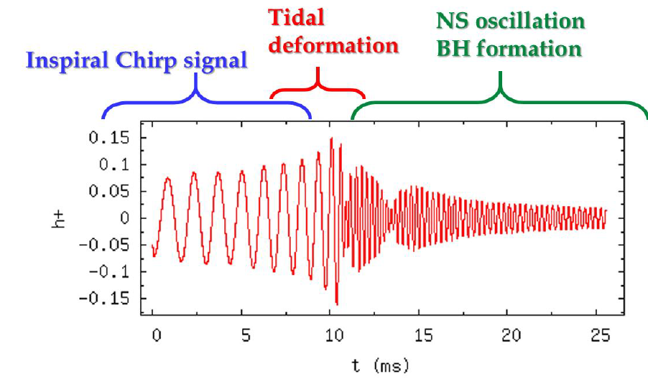
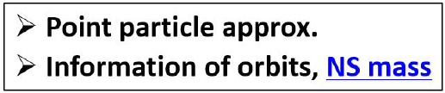
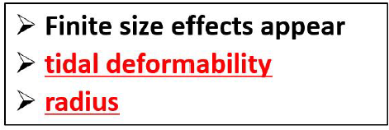
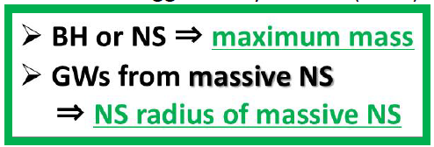
Constrain EoS in GW era
Sekiguchi’s talk in QCS2017
NS or QS or BH ? ( Nuclear Physics; Astrophysics; Numerics)

Slide 3
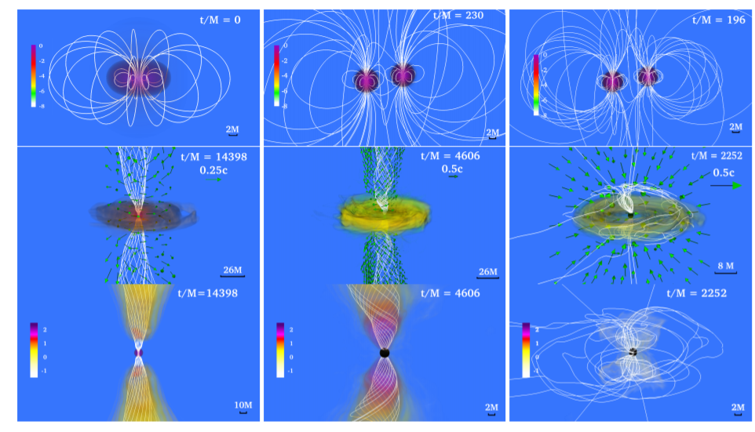
GRBs and HMNS
Ruiz et al. 2018

Slide 4
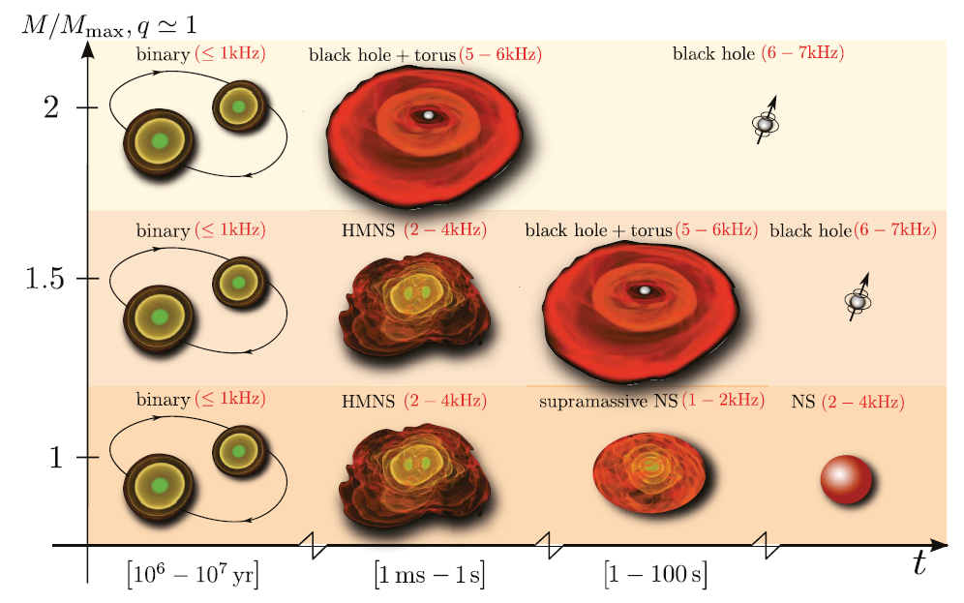
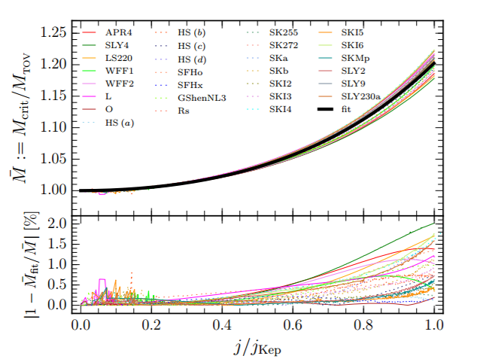
GRBs and HMNS
Breu & Rezzolla 2016
Rezzolla & Zanotti 2013

Slide 5
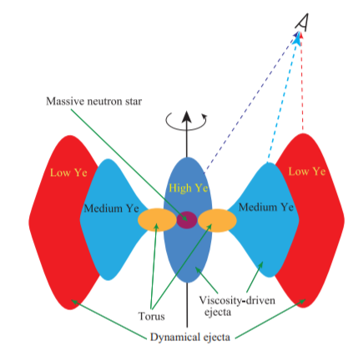
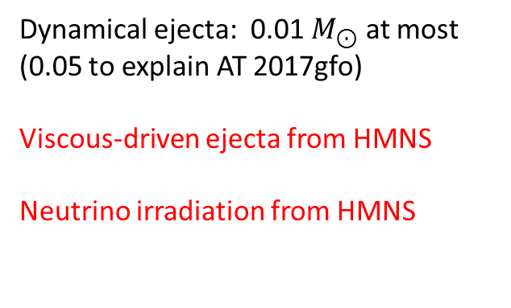
Ejecta and HMNS
Dynamical ejecta: 0.01 $M_{⊙}$ at most
(0.05 to explain AT 2017gfo)
Viscous-driven ejecta from HMNS
Neutrino irradiation from HMNS
Shibata et al. 2017
Question: How about quark stars?

Slide 6
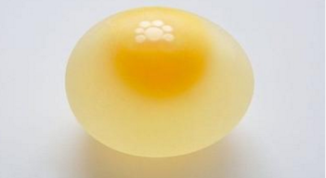
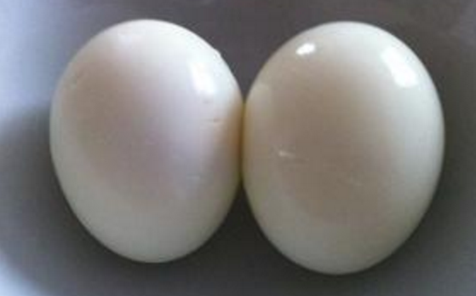
NS vs QS
crust/superfluidity/exotic core unified/finite surface density
raw egg cooked egg
They are different in terms of deformability (see Li’s talk) and spinning..
Uniformly RQS can become 40% more massive than it’s TOV limit, compared to 20% for NSs.
What about differential rotation?

Slide 7
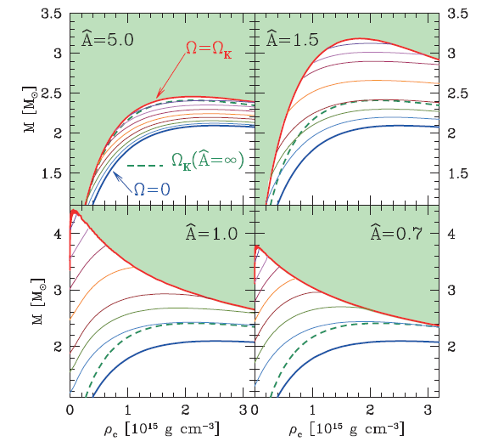


Differentially RNS
Differentially rotation law:
J-const law
(Newtonian limit):
Rezzolla & Zanotti 2013

Slide 8
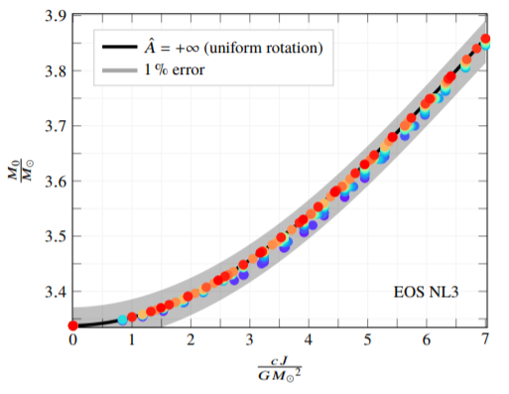
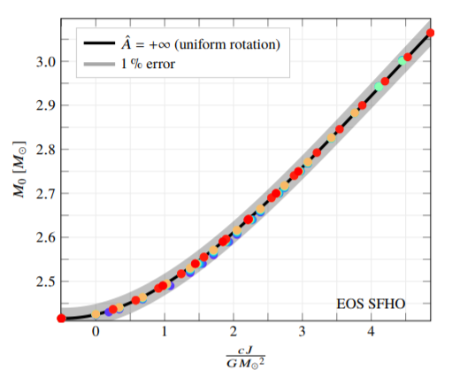
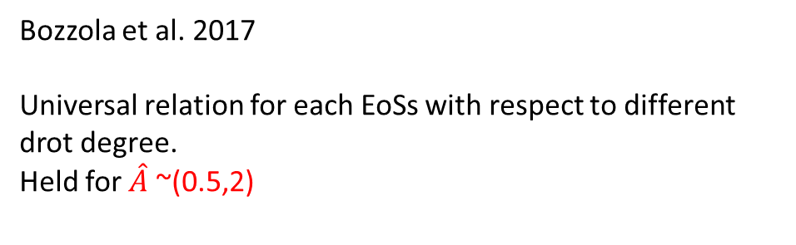
Differentially RNS
Bozzola et al. 2017
Universal relation for each EoSs with respect to different drot degree.
Held for $\hat{A}$ ~(0.5,2)

Slide 9
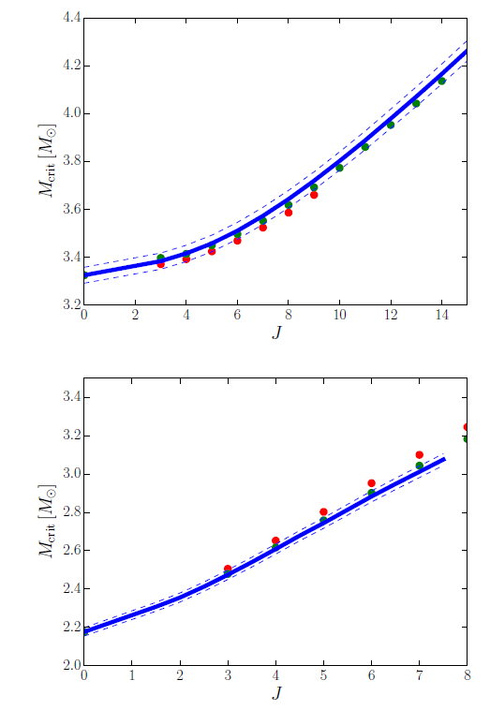
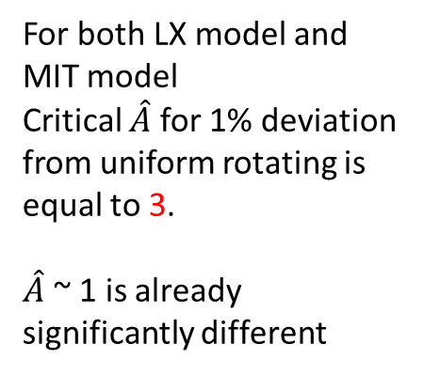
Drot RQS
For both LX model and MIT model
Critical $\hat{A}$ for 1% deviation from uniform rotating is equal to 3.
$\hat{A}$ ~ 1 is already significantly different
The GR initial data code
Compact Object CALculator
is modified to accommodate the calculation of quark stars to produce those results.

Slide 10
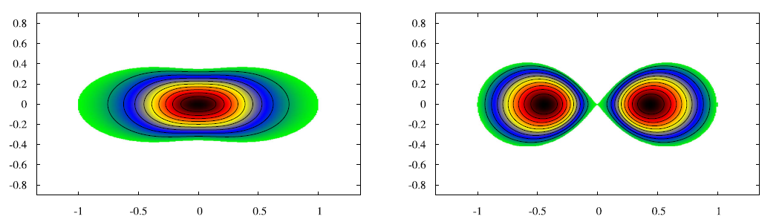
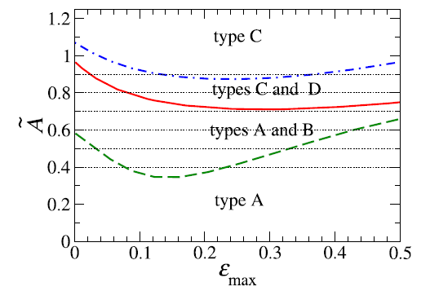
Type C Drot NS
Type C solutions more significant for Drot QS
Ansorg et al. 2016
For drot NSs

Slide 11
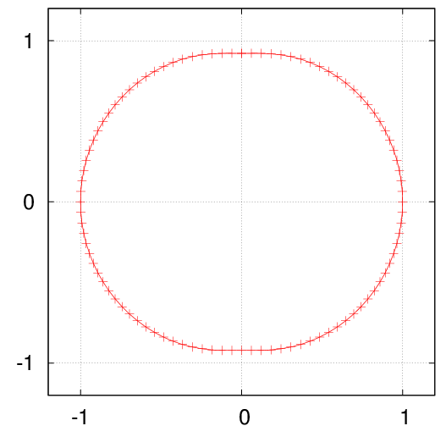
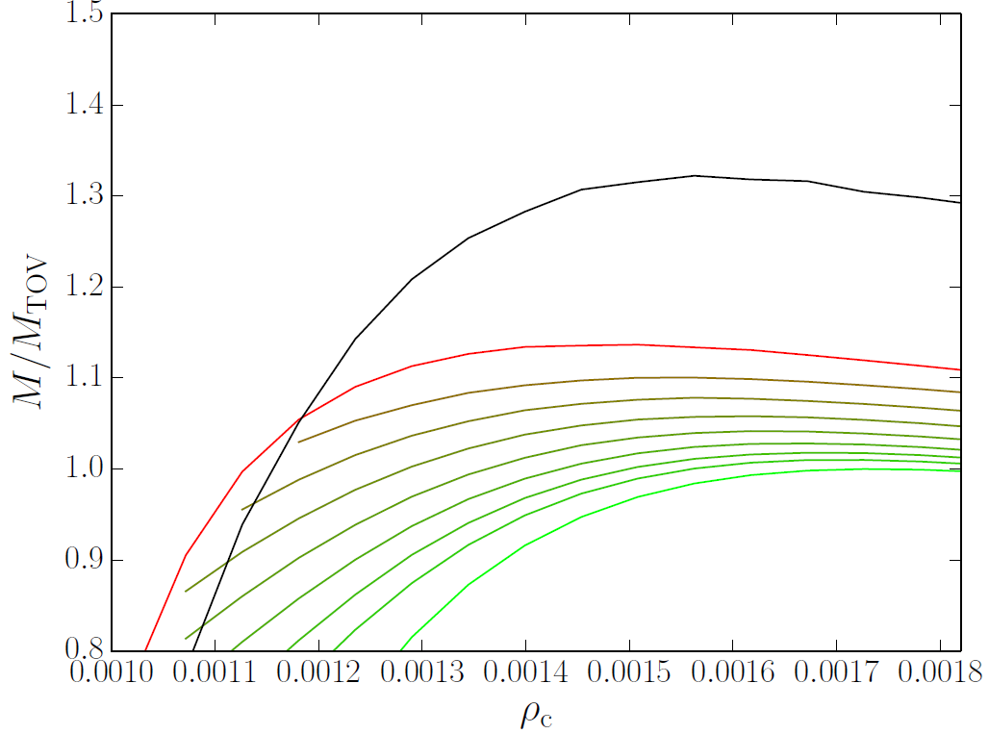
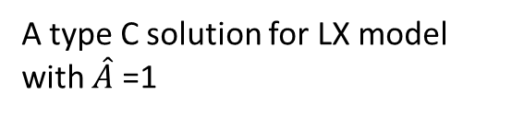
Type C Drot RQS
Hyper-massive QS < Supra-massive QS!!
More mass ejected
A type C solution for LX model with $\hat{A}$ =1

Slide 12
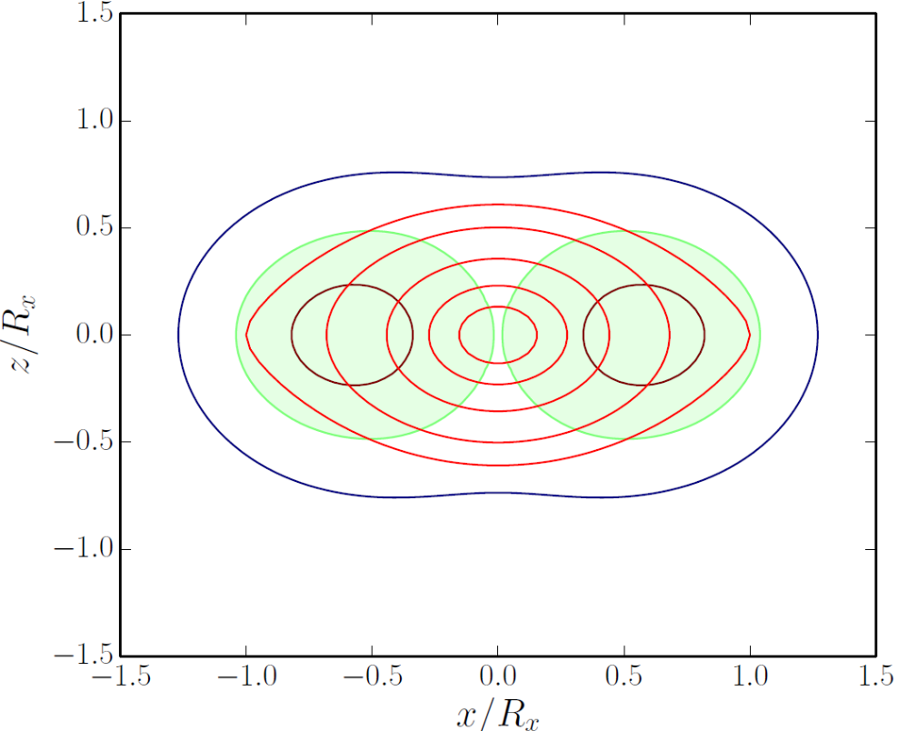
Ergosphere in RQS
0.1 Solar mass (10^53 erg) energy release to a configuration when ergosphere just disappears.
Timescale:??
A RQS with an ergosphere can play the role of a black hole, and more than a black hole.
Spherical M/R=0.4 Mass shedding limit

Slide 13
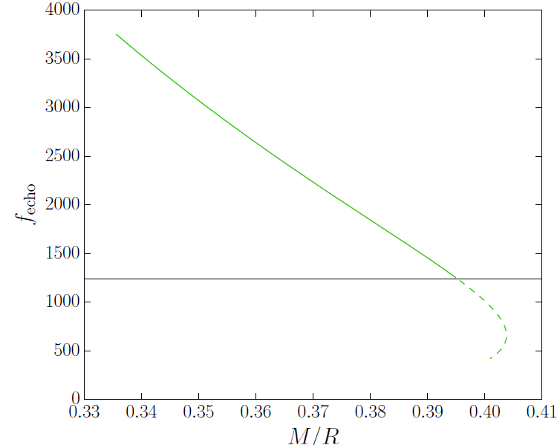
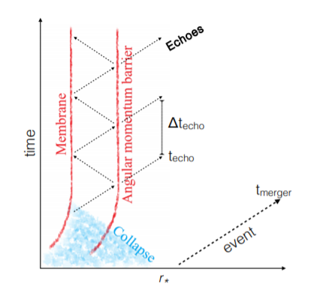
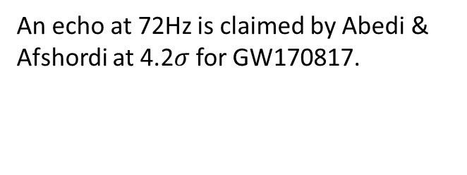
Ergosphere in RQS
GW echo
The compactness of a QS can exceed 1/3, but not enough to explain the low frequency of the echo.
Ergoshpere can reduce this frequency to 0.
An echo at 72Hz is claimed by Abedi & Afshordi at 4.2$σ$ for GW170817.

Slide 14
Conclusion
EM counterparts of a binary merger event can tell a lot about the post merger phase (remnant type/lifetime/B-filed).
The post merger phase behavior is closely related to the rotating configuration of the compact star.
The rotating configuration is quite different for NS and QS in both uniform and differential rotating case.
Distinguish between NS and QS with EM counterpart of BNS mergers.
Thanks for your attention!

